Slide 1
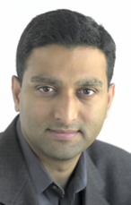
Speaker
Ramesh Raskar is Associate Professor at Media Lab, MIT.
He was previously a Senior Research Scientist at MERL. His research interests include projector-based graphics, projective geometry and non-photorealistic rendering. During his doctoral research at U. of North Carolina at Chapel Hill, he developed a framework for projector based 3D graphics, which can simplify the constraints on conventional immersive displays, and enable new projector-assisted applications. He has published several articles on immersive projector-based displays, spatially augmented reality and has introduced Shader Lamps, a new approach for projector-based augmentation. His technical papers have appeared in SIGGRAPH, EuroGraphics, IEEE VR, IEEE Visualization, CVPR and many other graphics and vision conferences. He was a course organizer and speaker for Siggraph 2002-2007. He is a member of the ACM and IEEE.
http://raskar.info
http://www.media.mit.edu/~raskar

Slide 2
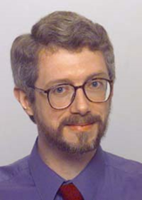
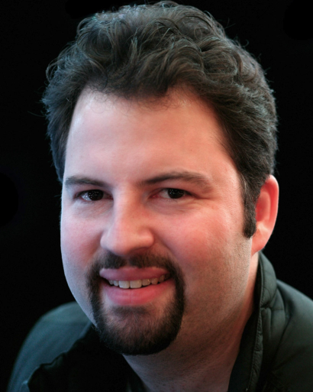
Raskar (MIT)
Tumblin (Northwestern)
Debevec (USC-ICT)

