Slide 1
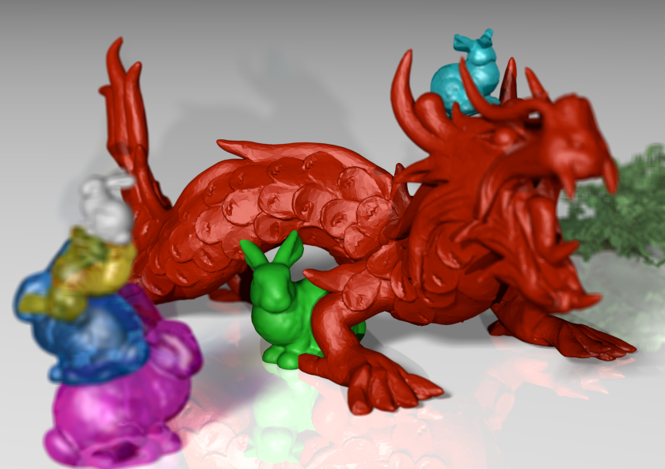
Compressive Light Field Photography using Overcomplete Dictionaries and Optimized Projections
Kshitij Marwah¹ Gordon Wetzstein¹ Yosuke Bando^{2,1} Ramesh Raskar¹
¹MIT Media Lab ²Toshiba Corporation

Slide 2
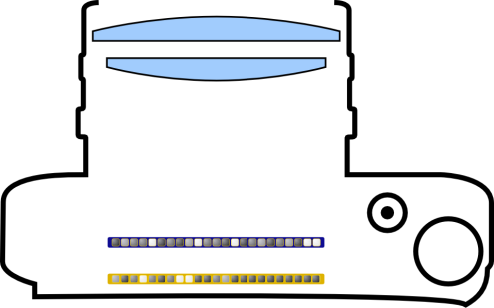
Scene from
Above
Conventional Photo – Large Aperture

Slide 3
Scene from
Above
Conventional Photo – Small Aperture

Slide 4
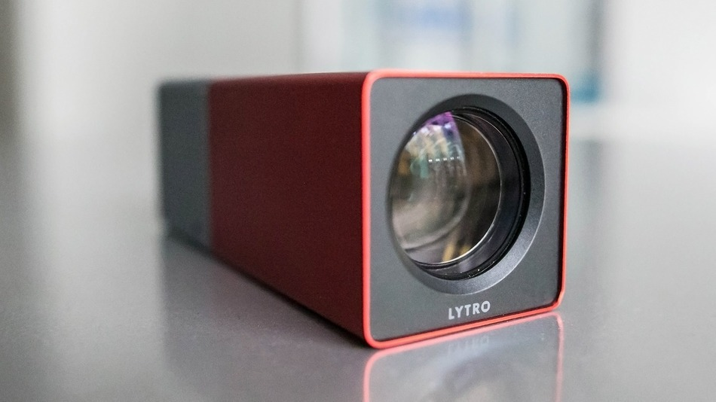
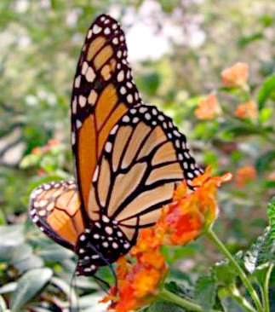
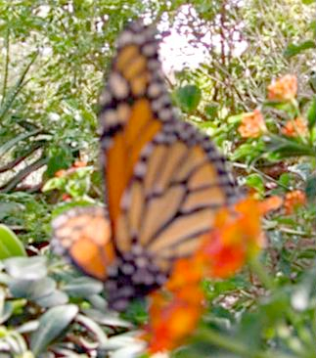

Slide 5
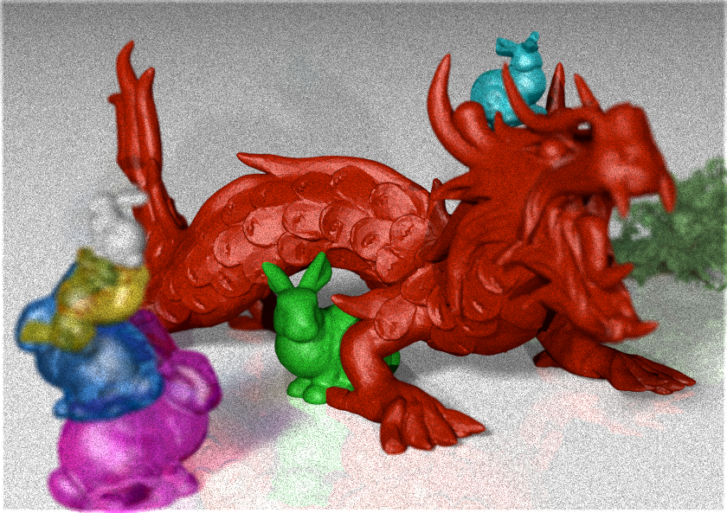
Scene from
Above
Proposed Technology: Mask-Coded Light Field Projection
Coded Attenuation Mask

Slide 6
Scene from
Above
Light Field

Slide 7
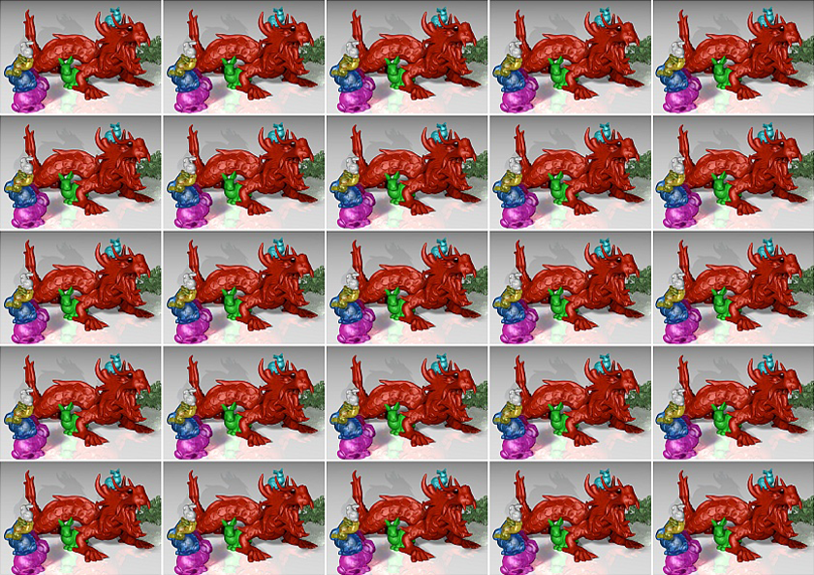
Scene from
Above
Light Field

Slide 8
Scene from
Above
Applications: Image Refocus

Slide 9
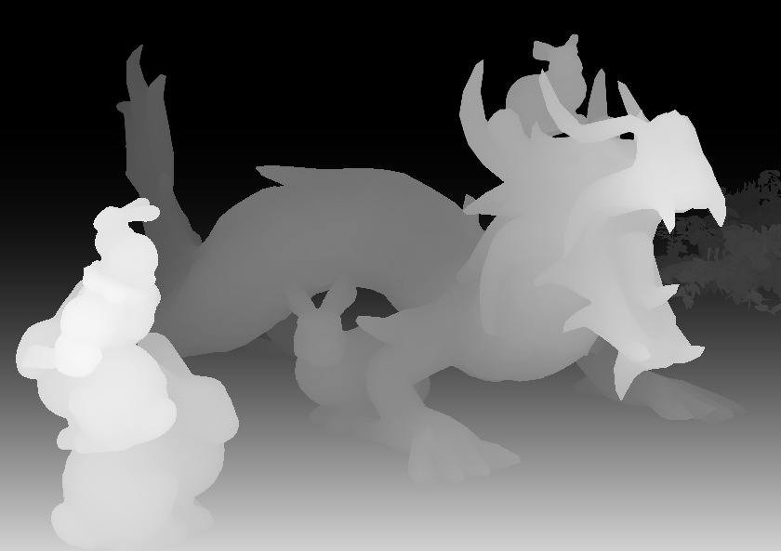
Scene from
Above
Applications: Depth, Segmentation, Object Recognition, …

Slide 10
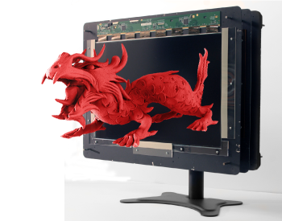
Scene from
Above
Applications: Change Viewpoint & 3D Display
e.g., Tensor Displays [Wetzstein et al. 2012]

Slide 11
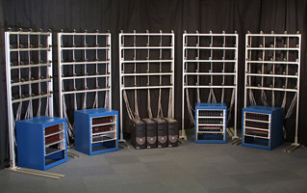
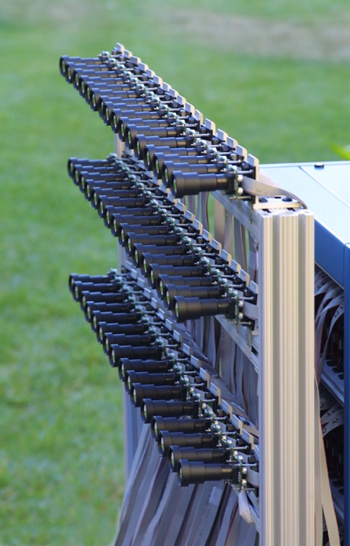
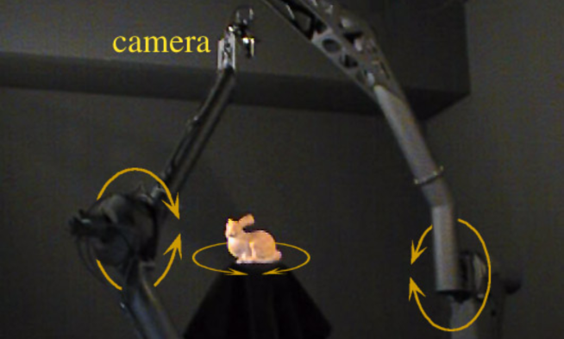
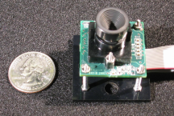
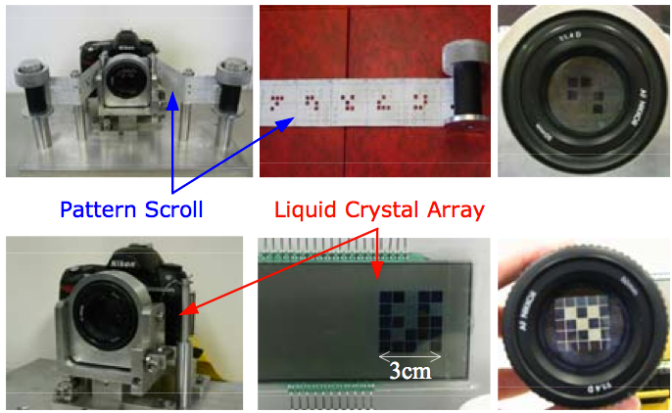
How is it done today?
Camera Arrays
e.g., [Wilburn et al. 2002,2005]
Sequential Acquisition
e.g., [Levoy and Hanrahan 1996],
[Liang et al. 2008]

Slide 12
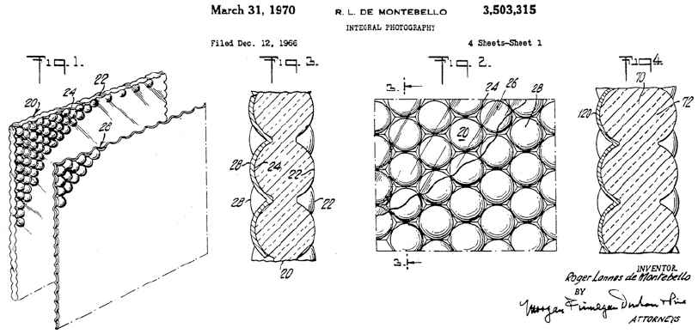
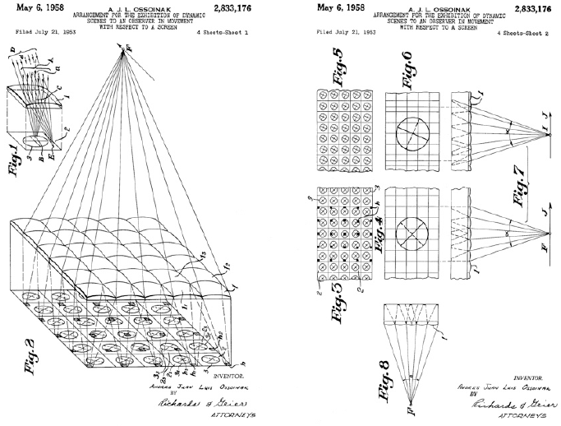
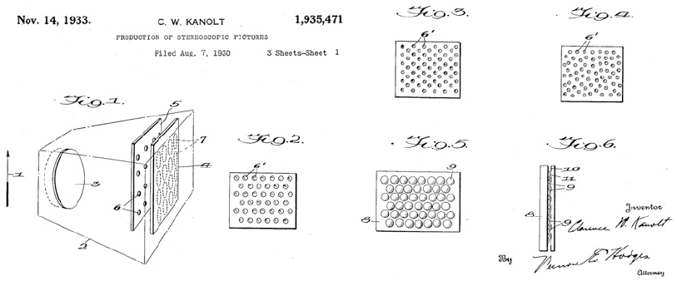
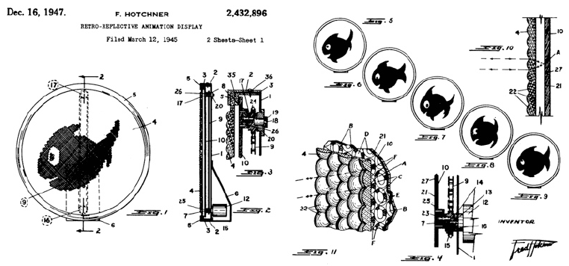
Most Popular Approach
Integral Imaging - Lippman 1908

Slide 13
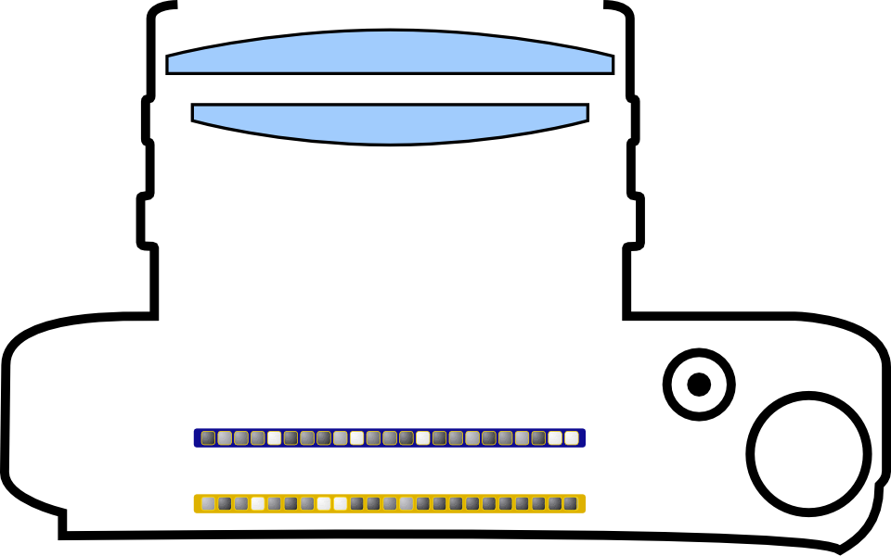
Scene from
Above
Integral Imaging
# Sensor Pixels Y
Lenslet Array
# Sensor Pixels X
[Lippman 1908], [Adelson and Wang 1992], [Ng et al. 2005]

Slide 14
Scene from
Above
Integral Imaging

Slide 15
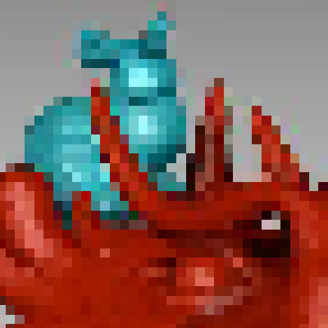
Scene from
Above
Integral Imaging: Spatio-Angular Resolution Tradeoff!
Spatio-Angular Resolution Tradeoff!
Example
Sensor with 2000 x 1000 pixels
# Sensor Pixels Y / # Views Y
5 x 5 light field views,
each with 400 x 200 pixels
our approach: explore ways to
overcome resolution tradeoff!
# Sensor Pixels X / # Views X

Slide 16
Scene from
Above
Light Field is Redundant!

Slide 17
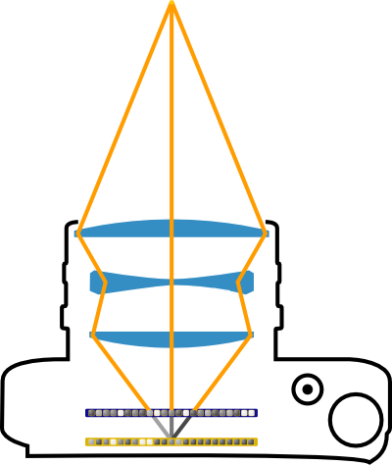
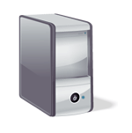
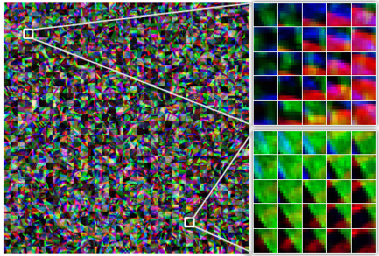
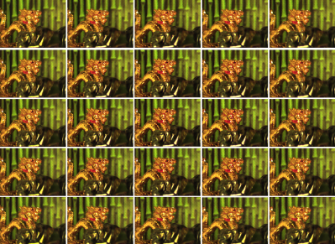
Key Insights
Exploit
redundancy
Sparsify
Preserve
information
Compressive
Reconstruction
Light Field Atoms
Mask-based
Light Field Coding

Slide 18
Exploit
redundancy
Sparsify
Preserve
information
Compressive
Reconstruction
Light Field Atoms
Mask-based
Light Field Coding

Slide 19
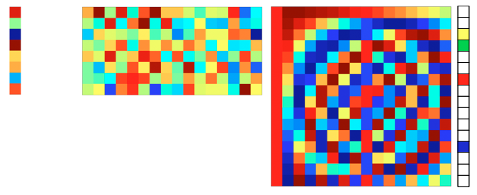
Compressive Sensing
=
=
Sparse Bases: DCT, Wavelets, etc.

Slide 20
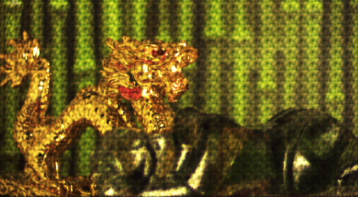
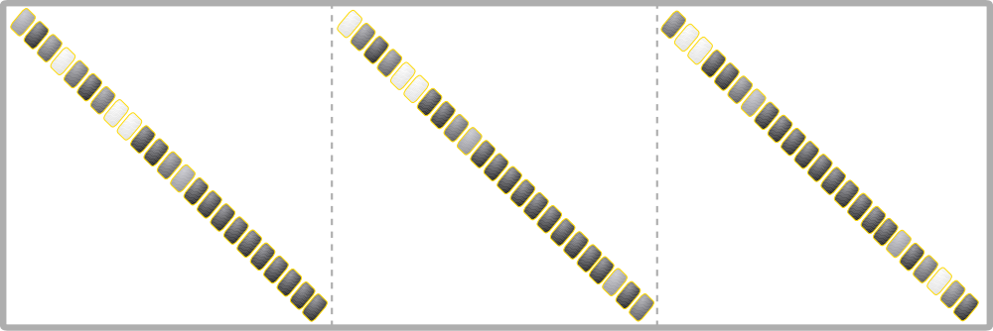
Compressive Light Field Reconstruction
Mask-Coded Projection
=
Captured 2D Image
4D Light Field
Sparse Coefficients!
Basis Pursuit Denoise:
4D Reconstruction

Slide 21
Exploit
redundancy
Sparsify
Preserve
information
Compressive
Reconstruction
Light Field Atoms
Mask-based
Light Field Coding

Slide 22
Compressive Light Field Representation
=
such that
is sparse
Light field vector
Basis matrix
Coefficient vector
Basis
matrix
Only a few non-zero coefficients
=
Similar to DCT in JPEG
But DCT is not enough
for light field reconstruction

Slide 23
Compressive Light Field Representation
=
s.t.
is sparse
Light field vector
Dictionary
Coefficient vector
Overcomplete
dictionary
Can lead to fewer
non-zero coefficients
=

Slide 24
Dictionary Learning
=
i
i
s.t.
i
is sparse
Training light field
Dictionary
Coefficient vector
for all
i
Sample 1,000,000 random 4D patches from training light fields

Slide 25
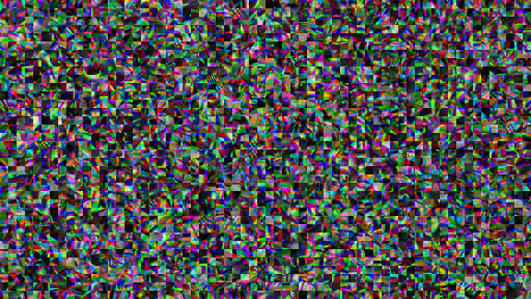
Light Field “Atoms” in Dictionary
Light fields can be represented by only a few of these atoms
5,000 atoms, each 9x9 pixels and 5x5 views

Slide 26
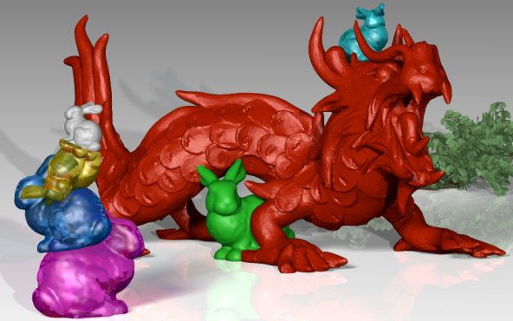
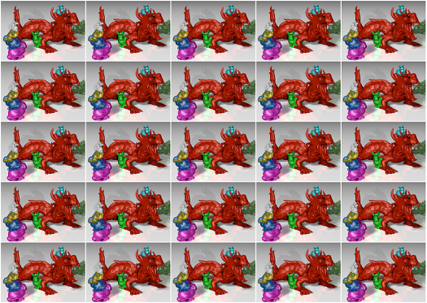
Compressibility Evaluation
Light field atoms have better
compression performance
than other standard bases

Slide 27
Exploit
redundancy
Sparsify
Preserve
information
Compressive
Reconstruction
Light Field Atoms
Mask-based
Light Field Coding

Slide 28
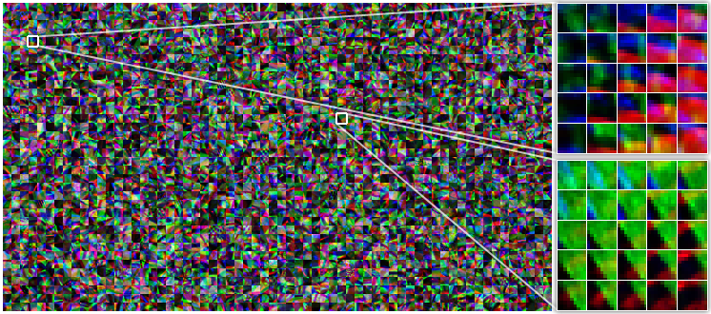
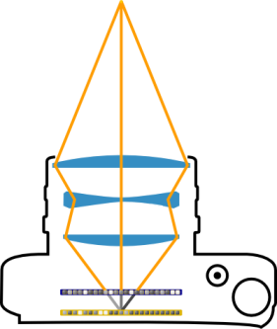
Optical Preservation of Light Field Info
=
Image
Coded projection
Light field
Dictionary
Coefficient vector
Overcomplete
dictionary
=
Light field atoms
We need to be able to distinguish atoms from their projections

Slide 29
Scene from
Above
Previous Mask-Coded Light Field Projection
Parallax Barriers
[Ives 1903]
Sum of Sinusoids or MURA
[Veeraraghavan 2007, Lanman 2008]
Multiplexing + linear reconstruction
Low resolution light fields similar to the lenslets design
“On Plenoptic Multiplexing and Reconstruction”, IJCV, Wetzstein et al. 2013

Slide 30
Scene from
Above
Proposed Technology: Optimized Mask w.r.t. the Dictionary
=
Image
Coded projection
Dictionary
Coefficients
Overcomplete
dictionary
=
Light field atoms
Multiplexing + nonlinear reconstruction
Higher spatial resolution

Slide 31
Scene from
Above
Proposed Technology: Mask-Coded Light Field Projection
random and optimized optical codes
multiplexing & nonlinear reconstruction

Slide 32
Light Field Camera - Optical Design
Lenslet Arrays
[Lippman 1908]
Parallax Barriers
[Ives 1903]
MURA – Linear Reconstruction
[Veraraghavan 2006, Lanman 2007]
μ=0.41
μ=0.3793
μ=0.3793
lenses
mask
mask
Optimized Codes
Proposed Approach – Nonlinear Reconstruction!
Random Codes Optimized Codes
Overcomplete Dictionary
μ=0.3790
μ=0.3768
mask
mask
Notes:
possibly add multishot slide after this one

Slide 33
Optical Designs for Preserving Light Field Information
Lenslet array
[Lippmann 1908, Ng 2005]
Pinhole mask
[Ives 1903]
MURA mask + linear reconstruction
[Veeraraghavan 2007, Lanman 2008]
lenses
mask
mask
Proposed approach
Overcomplete Dictionary
Optimized mask + nonlinear sparse reconstruction
mask

Slide 34
Optical Designs for Preserving Light Field Information
Lenslet arrays
[Lippmann 1908, Ng 2005]
Structured masks
[Ives 1903, Veeraraghavan 2007, Lanman 2008]
μ = 0.4119
lenses
mask
μ = 0.3793
Proposed approach: pseudo-random mask
optimized for the dictionary
mask
μ = 0.3768
Dictionary

Slide 35
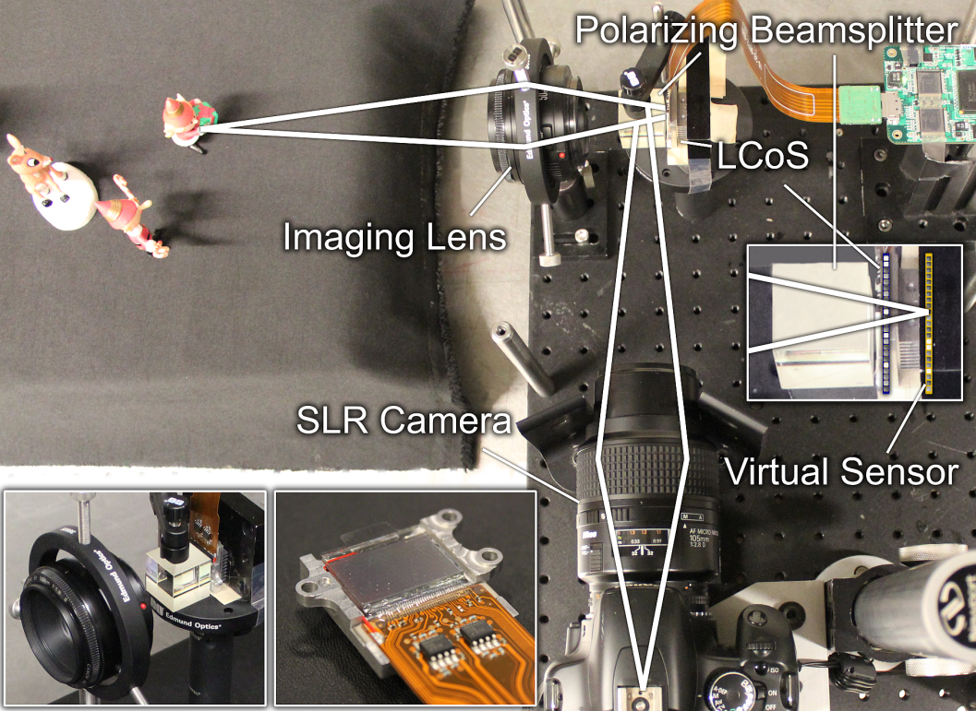
Prototype Setup with a Variable Mask
Polarizing
Beamsplitter
Imaging
Lens
Virtual sensor
LCoS
Camera
Image sensor

Slide 36
Results

Slide 37
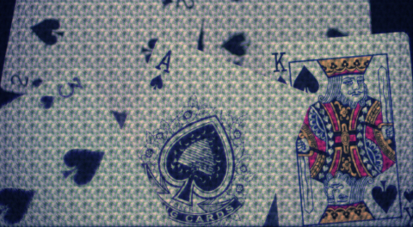
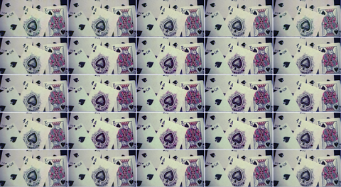
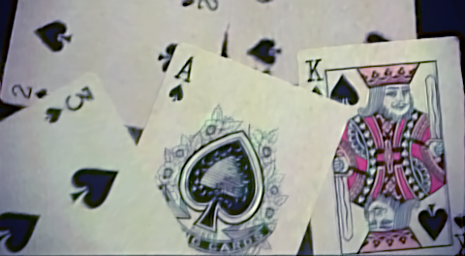
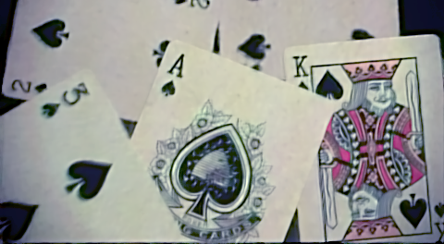
Diffuse Scene
Coded 2D Projection
Reconstructed 4D Light Field

Slide 38
Diffuse Scene
Coded 2D Projection
Reconstructed 4D Light Field

Slide 39
Refocus
Rear Focus
Front Focus

Slide 40
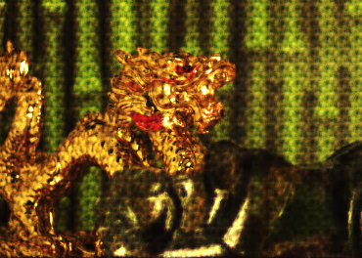
Glossy Scene with Refraction
Coded 2D Projection
Reconstructed Light Field
5x5 viewpoints

Slide 41
Single Shot = Animations!

Slide 43
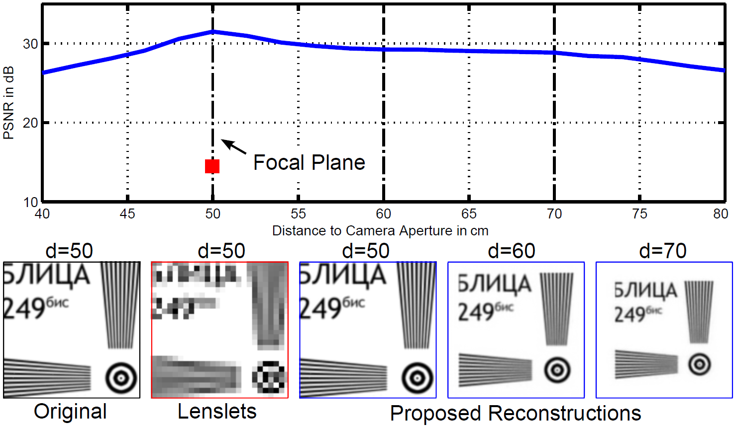
Depth of Field Evaluation
Effective resolution decreases
away from the focal plane
Still better than conventional
methods
Center view of the reconstructed light fields

Slide 44
Additional Applications – Compression
Light field represented by most significant coefficients only
5
4D DCT
4D Light Field Atoms
4D DCT
4D Atoms

Slide 45
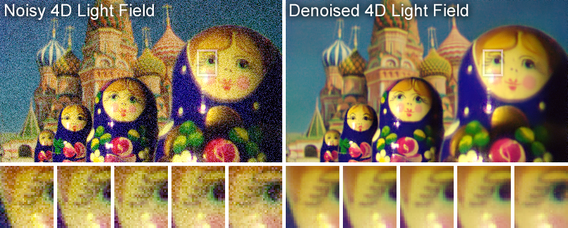
Additional Applications – Denoising

Slide 46
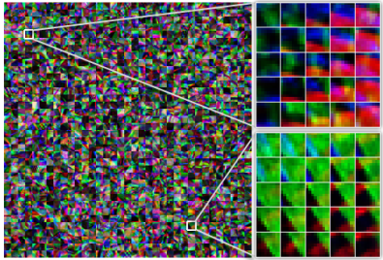
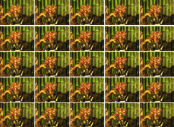
Summary
Compressive light field photography
Recovers multiple (5x5) views from a single coded image
Higher spatial resolution than previously possible
Three key components to leverage light field redundancy
Light field atoms, mask coding, and compressive reconstruction

Slide 47
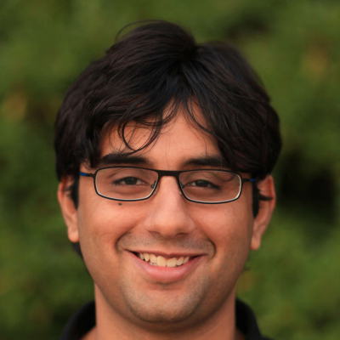
Faster computation
Higher resolution
Ashok Veeraraghavan
Kaushik Mitra
Micha Feigin
NSF & DARPA
Kshitij Marwah
Future implementation
Code & datasets will be available at:
cameraculture.media.mit.edu/CompressiveLightfieldPhotography

Slide 49
Distinguishability & Its Optimization
=
Image
Mask-coded projection
Dictionary
Coefficient vector
Mutual coherence
(lower, the better)
,
= column_normalize
MURA
Random
Optimized
μ = 0.3793
>
μ = 0.3790
>
μ = 0.3768

Slide 50
Dictionary Learning
1. Capture Light Field Training Set
2. Select 1,000,000 random 4D patches 3. Apply standard techniques – KSVD, SPAMS, etc.
x
x
x
x
x
x
x
x
x
x
x
x
x
x
x
x
x
x
x
x
x
x
x
x
x
x
x
x
x
x
x
x
x
x
x
x
x
x
x
x
x
x
x
x
x
x
x
x
x
x
x
x
x
x
x
x
x
x
x
x
x
x
x
x
x
x
x
x
x
x
x
x
x
x
x
x
x
x
x
x
x
x
x
x
x
x
x
x
x
x
x
x
x
x
x
x
x
x
x
x
x
x
x
x
x
x
x
x
x
x
x
x
x
x
x
x
x
x
x
x
x
x
x
x
x
x
x
x
x
x
x
x
x
x
x
x
x
x
x
x
x
x
x
x
x
x
x
x
x
x
x
x
x
x
x
x
x
x
x
x
x
x
x
x
x
x
x
x
x
x
x
x
x
x
x
x
x
x
x
x
x
x
x
x
x
x
x
x
x
x
x
x
x
x
x
x
x
x
x
x

Slide 51
Compressibility
Target Light Field

Slide 52
Compressibility
4D DCT
4D Light Field Atoms
Compression w/ 12 Coeffs
4D Light Field Patch
Sensing & Reconstruction

