Slide 1
Subsurface Enhancement through Sparse Representations of Multispectral Direct/Global Decomposition
Achuta Kadambi, Hayato Ikoma,
Xing Lin, Gordon Wetzstein, Ramesh Raskar
Camera Culture Group

Slide 2
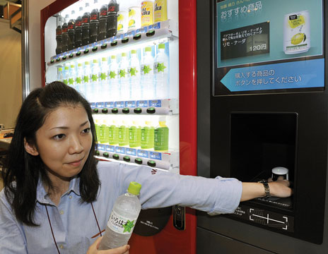
Importance of Subskin Imaging
*This technique uses transmission imaging. In context of skin, reflectance is more challenging.
Vending Machine Authenticates your purchase and targets advertisements
Hitachi Presented 2009.

Slide 3
Importance of Subskin Imaging
 | Iris | Voice | Face | FingerPrints | Vein
Ease of Use |  | ✓ | ✓ | ✓ | ✓
Cheap |  | ✓ | ✓ | ✓ | ✓
Accurate | ✓ |  |  | ✓ | ✓
Secure | ✓ |  |  |  | ✓
Vein is more secure than Fingerprints (hard to alter your vein pattern unless through surgery).
Cheap and Easy to Use compared with Iris Detection. Table from Strickland, IEEE Spectrum 2012.

Slide 4
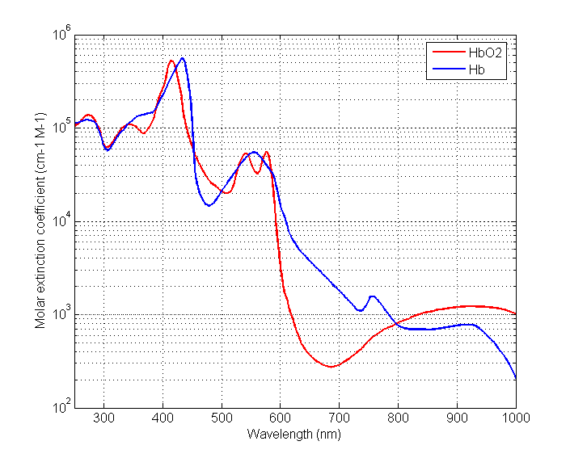
Vein-Viewing: Spectral Profile of Hb and HbO2
Isobestic Point: 810nm

Slide 5
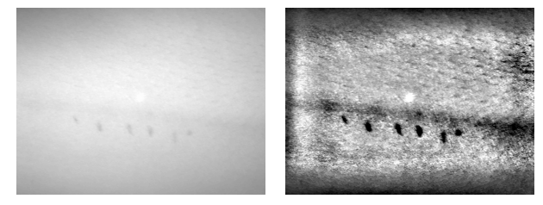
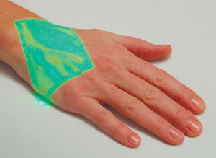
Multispectral Subskin Imaging
VeinViewer is limited as an imaging technique.
Computational aspect is basically multispectral imaging (two wavelengths) and contrast enhancement.
VeinViewer ™ Clinical Device
VeinViewer ™ Projects an overlay pattern to guide IV needles.
Several companies now use this technology (e.g. Accuvein).
Clinical feedback is mixed but represents win for Augmented Reality Community.
How to add Computation to the Loop?

Slide 6
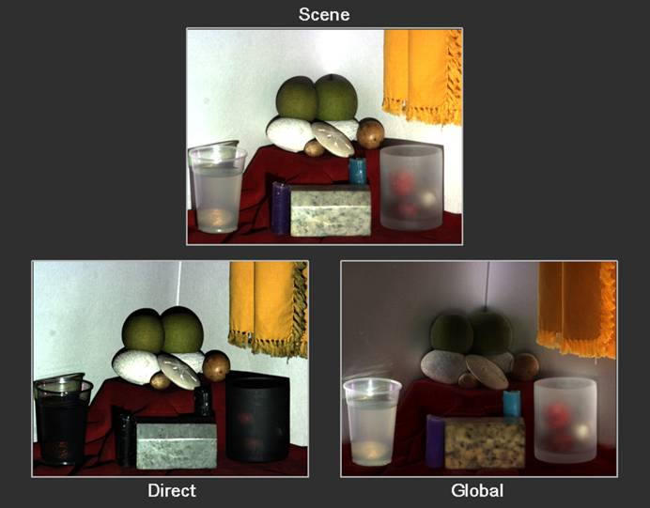
Direct and Global Separation
[Nayar, Krishnan, Grossberg, Raskar SIGGRAPH 2006]
Direct Illumination is a low frequency phenomena
Global Illumination is high Frequency phenomena.
Separation is straightforward: High frequency coded illumination and image subtraction.
Notes:
Relationship to Multipath

Slide 7
Our approach – Skin “Phantom”
Our computational approach combines multispectral with high-frequency coded illumination.to perform multispectral global and direct separation.
Notes:
Trace amounts of milk+cola.

Slide 8
Conventional Multispectral Photography
850 nm
700 nm
510 nm
430 nm

Slide 9
Direct/Surface Illumination
850 nm
700 nm
510 nm
430 nm
Global/Subsurface Illumination
850 nm
700 nm
510 nm
430 nm

Slide 10
Multispectral versus Multispectral Global-Direct
Multispectral
Multispectral
Global Direct

Slide 11
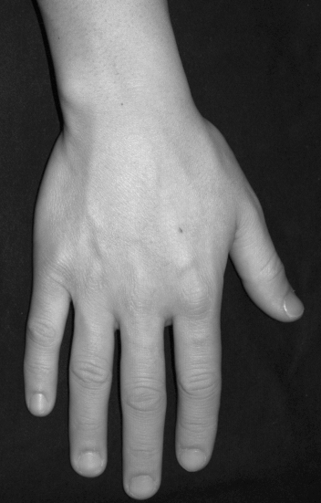
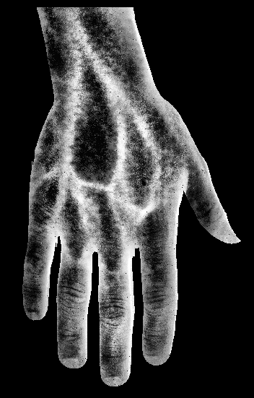
Applying the Technique
Veins are bright in the target image.

Slide 12
Characterizing Direct and Global Light Transport
Additive Decomposition
Direct Component
Global Component
Indirect Component
Light Source
x
Camera

Slide 13
Relationship between Global/Direct Transport and Subsurface Diffuser Imaging
Direct Component
Global Component
Light Source
Diffuser
x
$$I\left(x\right)=\int_{λ}{c(λ)l(x,λ)ρ(x,λ)dλ}$$
$$I\left(x\right)=\int_{λ}{c(λ)l(x,λ)(ρ_{d}(x,λ)+ρ_{g}(x,λ)dλ}$$
Camera
Subsurface
Pattern
$$ρ_{g}\left(x,λ\right)=\int_{z}{l(x,λ,z)(b(x,z)⊗s(x,λ,z))dz}$$

Slide 14
Ambiguities in Global Transport
Light
Source
Attenuation
Factor:
$$\frac{\cos^{2}θ}{D^{2}}$$
Different Light paths contribute to global illumination.
$$θ$$
x
Diffuser
Subsurface
Pattern

Slide 15
Blurring in the Global Image
Global Image: Blurred Version of Subsurface
Direct Image: Image of the Surface
Conventional Photograph = Direct+Global
x
Diffuser
Subsurface
Pattern

Slide 16
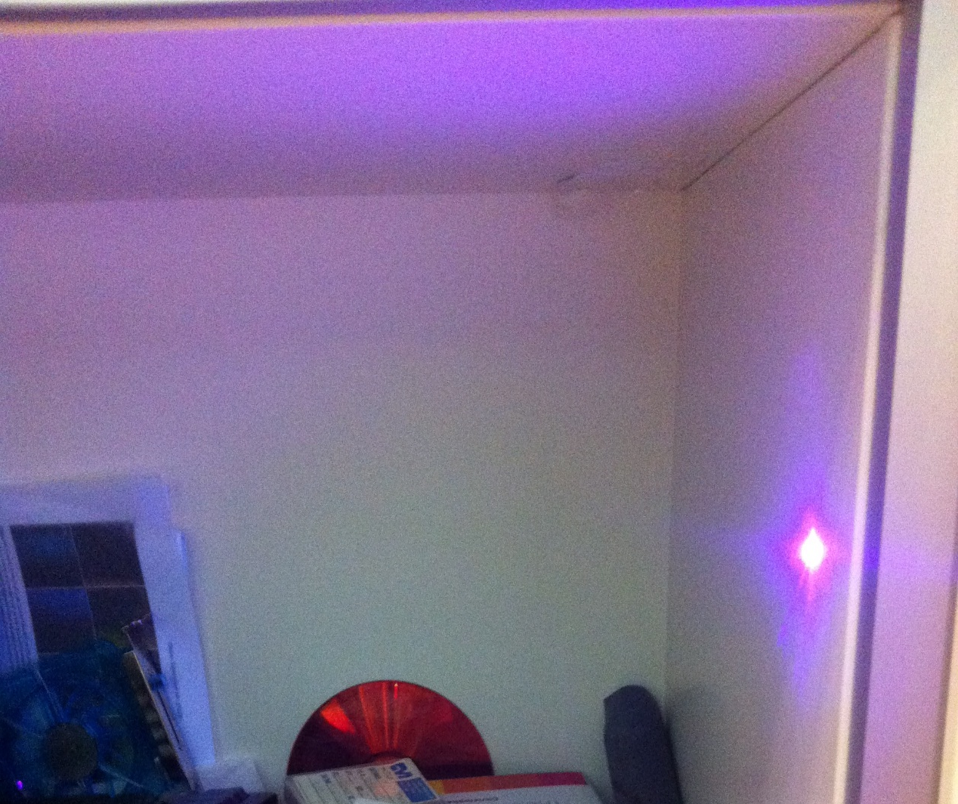
Frequency and Light Transport
Global
Illumination
Direct Illumination

Slide 17
Frequency and Light Transport
Take-Home:
Global Illumination → Low Spatial Frequency Phenomena.
Direct Illumination → High Spatial Frequency Phenomenon.
Global
Illumination
Direct Illumination

Slide 18
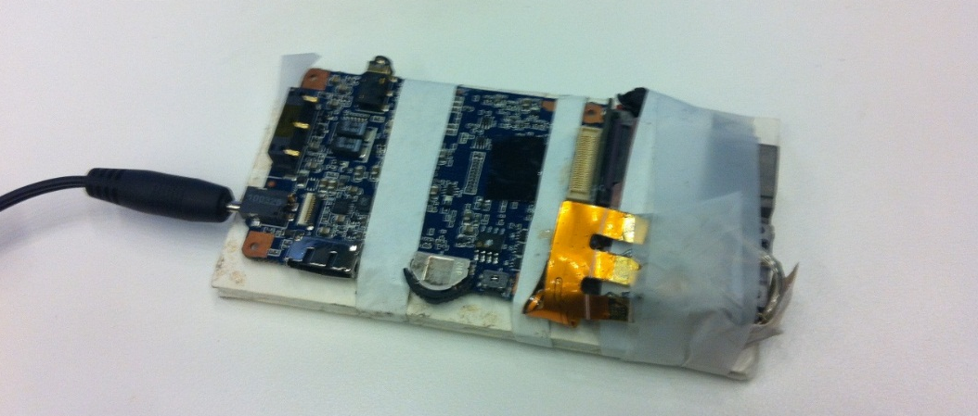
Combining Multispectral Global-Direct
Combination of multispectral global-direct is achieved by changing the wavelength of illumination (projector)
Optoma PK102 replaced with OSRAM SFH4232 850 nm
Acquired Dataset is a 4-hypercube
Intensity in
$g$ represents global or direct intensities.
$$\{x,y,λ,g\}$$
Notes:
This paper is an applications paper. Therefore we consider multispectral global direct.

Slide 19
Simple Implementation
Notes:
Simple Implementation

Slide 20
Visual Roadmap

Slide 21
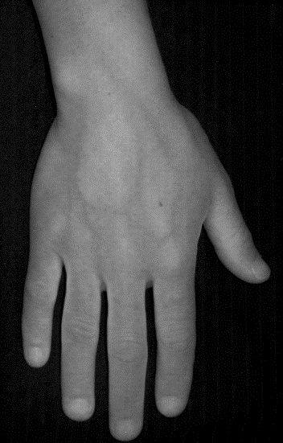
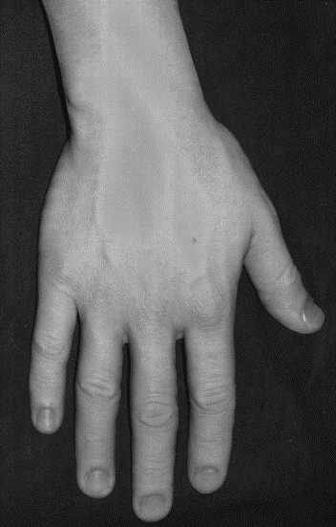
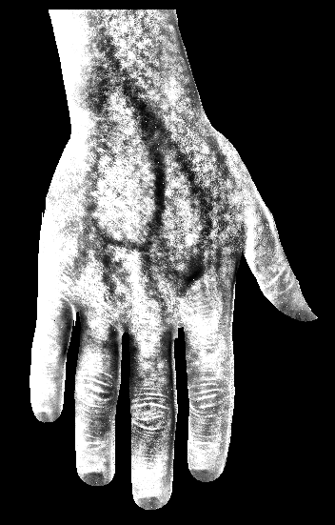
Conventional Imaging
Photograph
Computer
Graphics/Vision
Computational Photography
Global
Direct
Multispectral Global/Direct (Part I)
Spectral
Global
Spectral
Direct
Target Decomposition via Sparsity (Part II)
Target
Not Target

Slide 22
Sparse Coding
Inputs
Outputs
4-hypercube of Multispectral Direct and Global
Target Image and Not-Target Image: “Segmentation”

Slide 23
Decomposing Global Light Transport
$$𝒟$$
$$α^{\left(x\right)}$$
$$ρ^{\left(x\right)}$$
$$λ$$

Slide 24
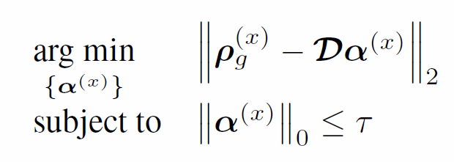
Promoting Sparsity for
Convex Relaxation
Classifying the Coefficient Vector

Slide 25
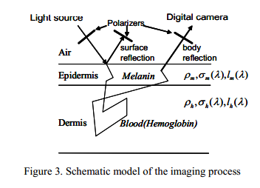
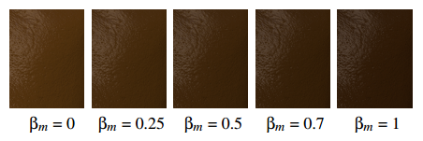
Forward Models of Spectral and Global Illumination in Graphics
Top row: Increasing amounts of Hemoglobin under the skin for rendering.
Bottom row: Increasing amounts of Melanin.
[Tsumura et al. SIGGRAPH 2003]
By incorporating hemoglobin and melanin information, Tsumura et al. is able to change the skin color of a 50 year old woman to a 20 year old.
[Donner et al. EGSR 2006]
At left, a plausible human face rendering by using Subsurface Scattering.
[Jimenez et al.
SIGGRAPH Asia 2010

Slide 26
Inverse Problem of Imaging
How can we decompose this image into subsurface targets?

Slide 27
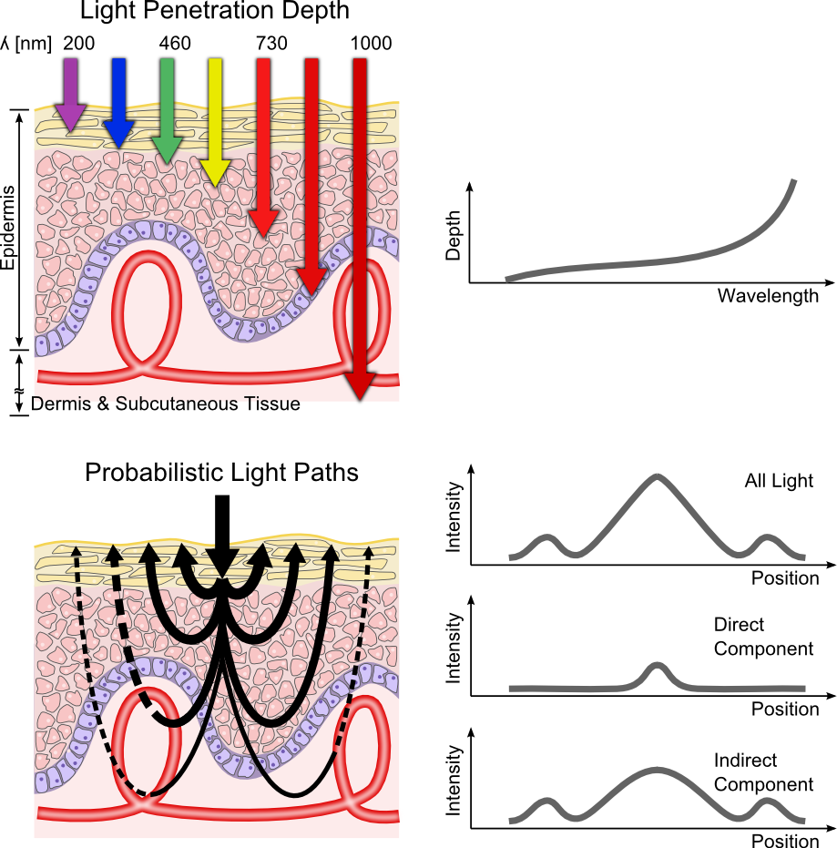
Combined Image Acquisition

Slide 28
Applying the Technique
Veins are the target

Slide 29
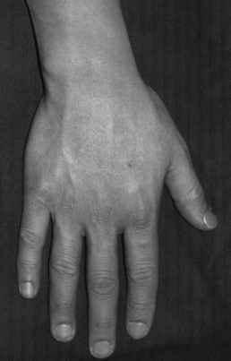
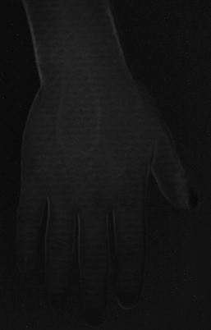
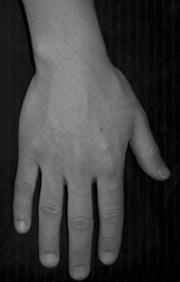
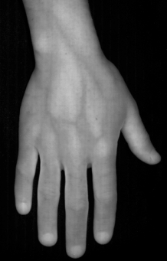
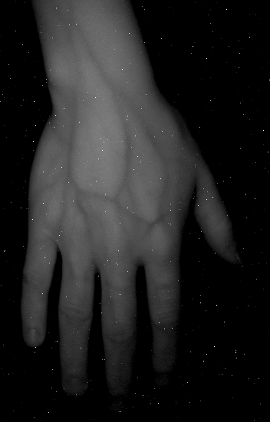
Differences between Direct and Global for Skin
430 nm
510 nm
700 nm
850 nm
Direct
Global

Slide 30
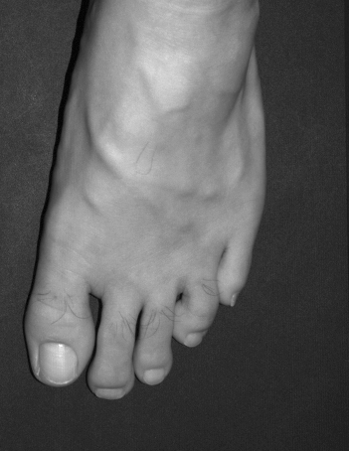
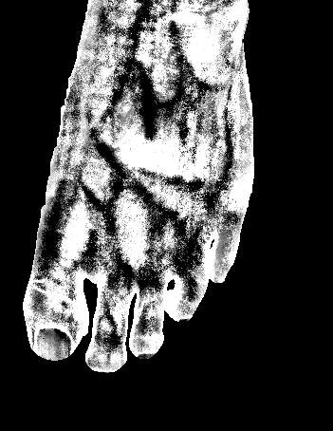
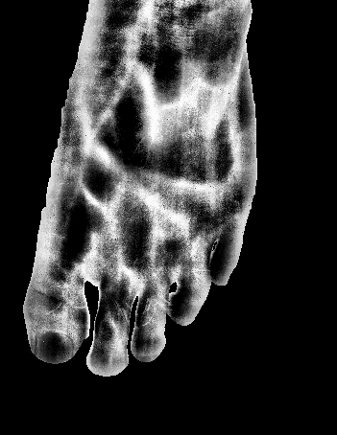
Decomposition into Target and Complement

Slide 31
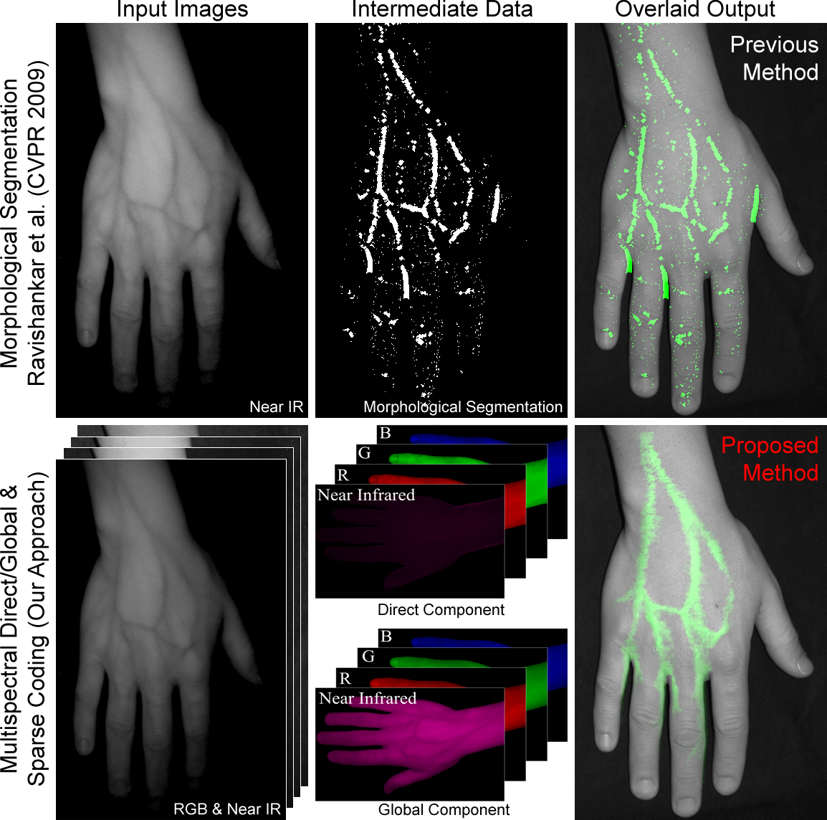
Segmentation/Contrast Enhancement

Slide 32
Scope
Acquisition is not “real-time”.
Limiting factor can be overcome in hardware → Motivates industry approach.
This talk assumes planar through diffuser techniques and does not perform descattering.
Rank of Dictionary is by no means limited to vein and not vein.
Sparsity not fully explored in the context of 4D acquisition. Number of measurements increases by square root of N, which opens up possibilities for Compressive framework.

Slide 33
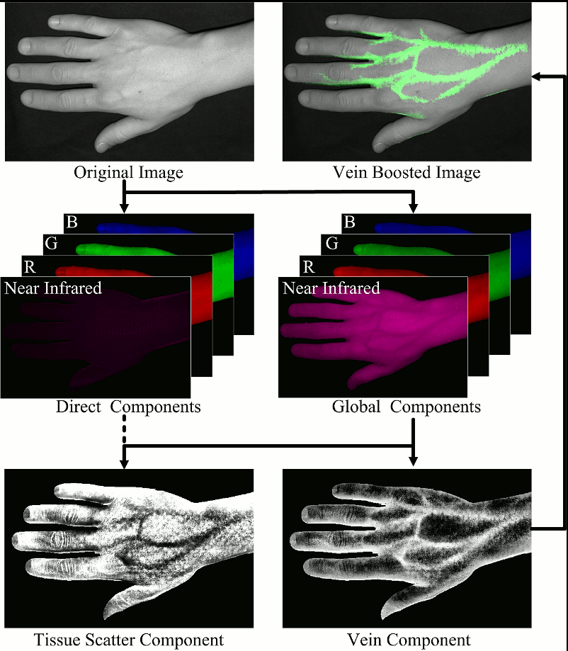
Looking Ahead
Achuta Kadambi: achoo@mit.edu
Discriminating photons via wavelength AND path properties encourages new computational applications.
Optical and Computational Co-design.
Technique is simple enough for industry transfer for subsurface imaging contexts.
Combining in context of Time Domain or Phase Imaging.
Additional Links:
Camera Culture Group, Mass. Inst Tech.
http://cameraculture.info
- If interested, opportunities in imaging for incoming graduate students who are thinking about applying to MIT. Also slots for postdoctoral researchers.

Slide 38
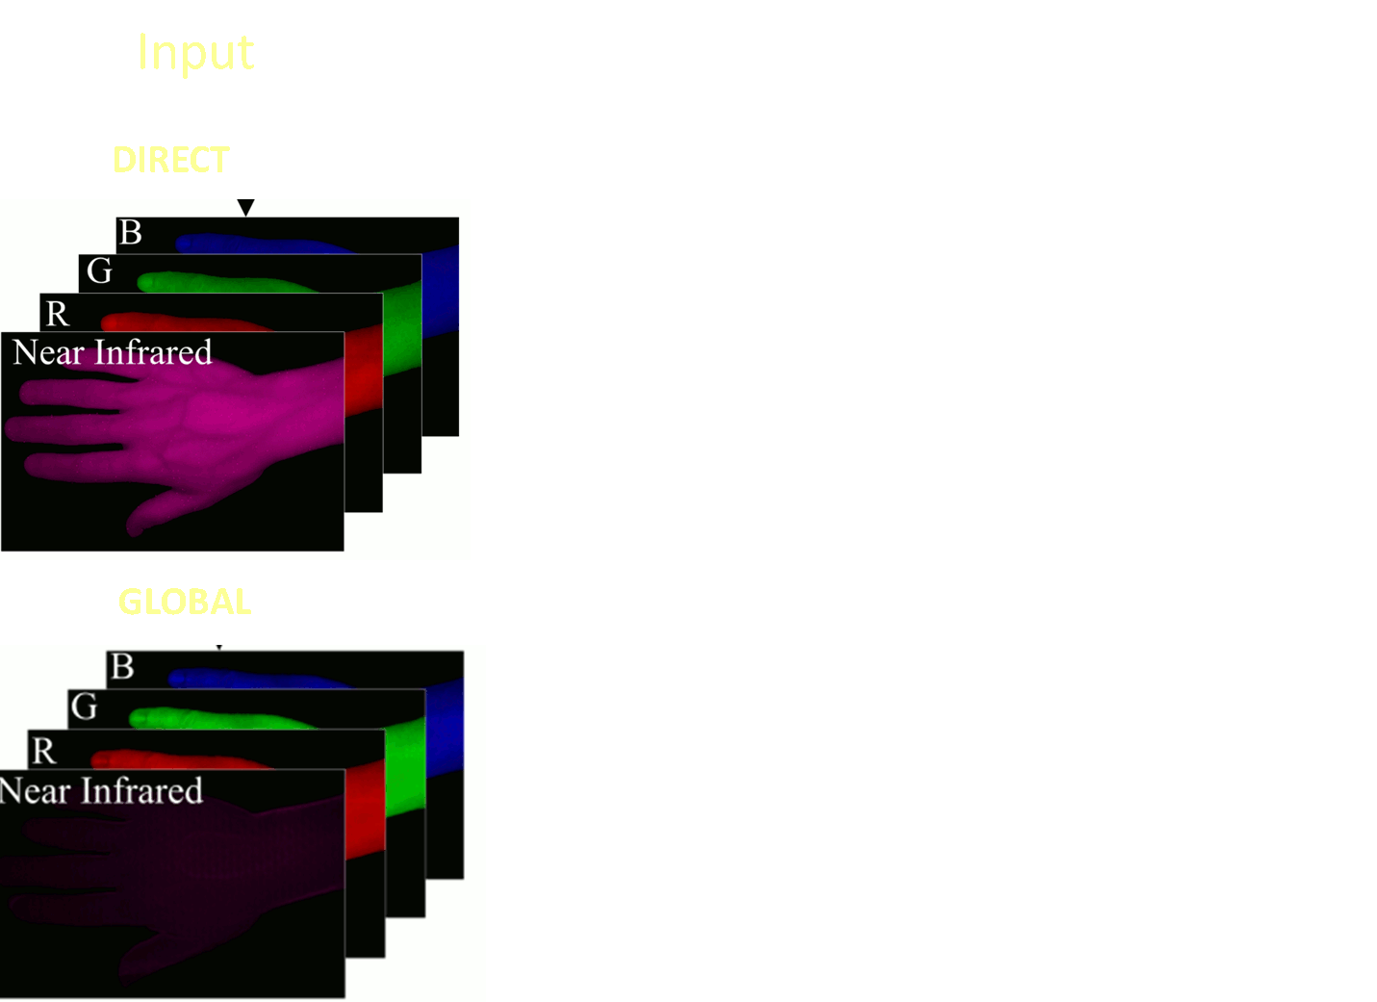

Slide 39
Selective Targeting

Slide 41
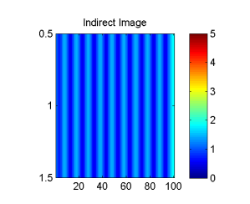
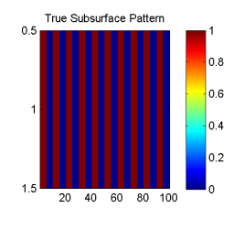
Simulating the Forward Model
Subsurface Pattern represents Albedo. Indirect Image represents measurements. Albedo and Intensity image are not on necessarily equivalent scales.

Slide 42
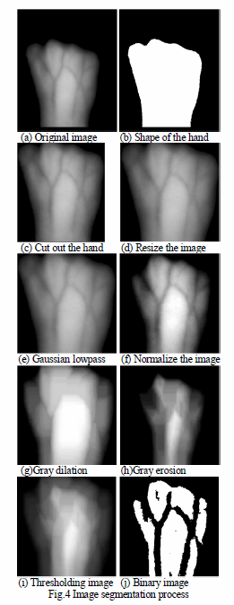
[Chen et al. Bioinformatics and Biomedical Engineering (ICBBE) 2007]

Slide 46
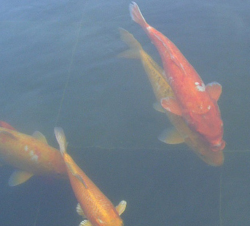
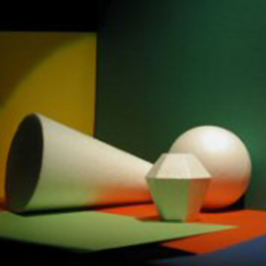
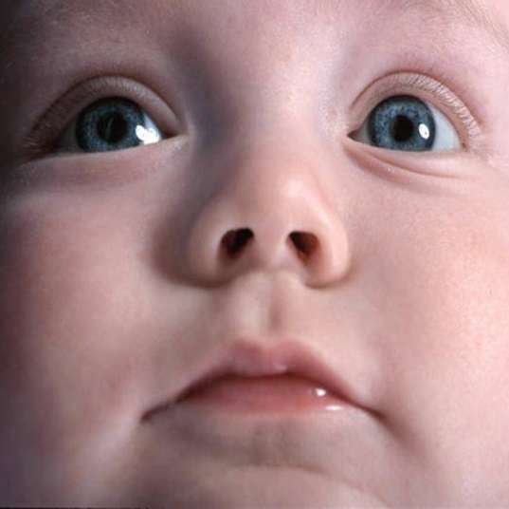
Direct and Global Illumination
participating
medium
surface
source
D
B
A
C
P
A : Direct
E
B : Interrelection
camera
C : Subsurface
translucent
surface
D : Volumetric
E : Diffusion

Slide 47
Direct and Global Components: Interreflections
surface
j
source
i
camera
radiance
direct
global
BRDF and geometry

Slide 48
Other Global Effects: Subsurface Scattering
translucent
surface
source
j
i
camera

Slide 49
Other Global Effects: Volumetric Scattering
participating medium
surface
source
j
i
camera

Slide 50
High Frequency Illumination Pattern
[Nayar, Krishnan, Grossberg, Raskar SIGGRAPH 2006]
surface
source
i
camera
+
fraction of activated source elements

Slide 51
High Frequency Illumination Pattern
[Nayar, Krishnan, Grossberg, Raskar SIGGRAPH 2006]
surface
source
i
camera
+
-
fraction of activated source elements

Slide 52
Separation from Two Images
[Nayar, Krishnan, Grossberg, Raskar SIGGRAPH 2006]
direct
global

Slide 53
Forward Model of Light Transport
$$I\left(x\right)=\int_{λ}{c(λ)l(x,λ)ρ(x,λ)dλ}$$
$$\left.c(λ\right)$$
$$\left.l(x,λ\right)$$
$$\left.ρ(x,λ\right)$$

Slide 54
Plugs
CS-MUVI Kevin Kelly.
E.g. 4D dataset and sparsity. Fourth root.
$$I\left(x\right)=\int_{λ}{c(λ)l(x,λ)(ρ_{d}(x,λ)+ρ_{g}(x,λ)dλ}$$

Slide 55
Blurring
$$ρ_{g}\left(x,λ\right)=\int_{z}{l(x,λ,z)(b(x,z)⊗s(x,λ,z))dz}$$

Slide 56
Frequency and Light Transport
Global
Illumination
Direct Illumination

