Slide 1
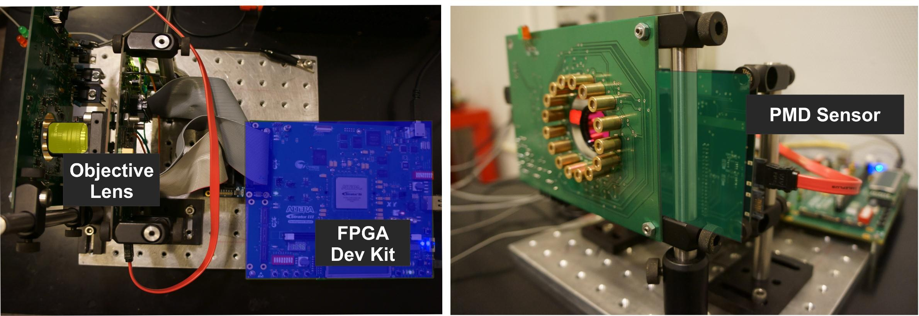
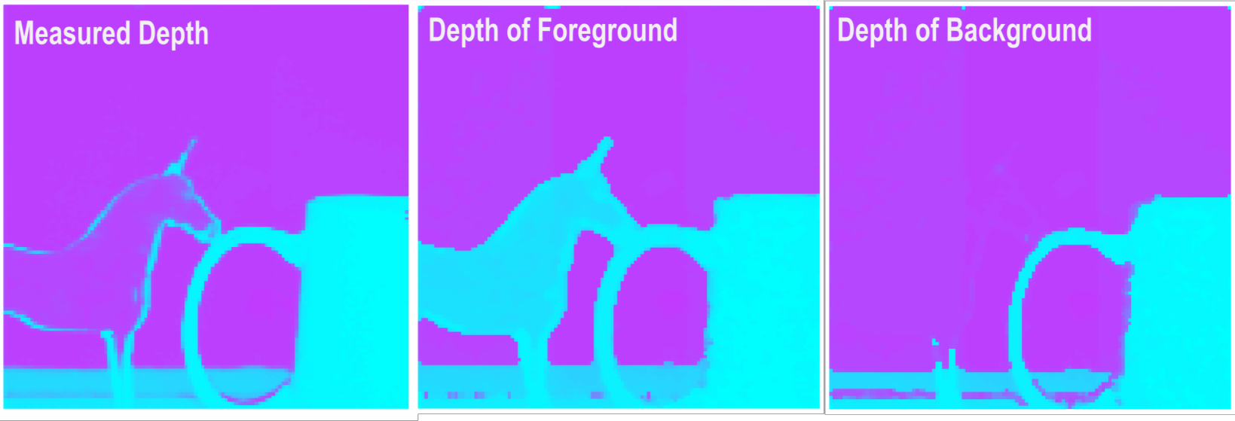
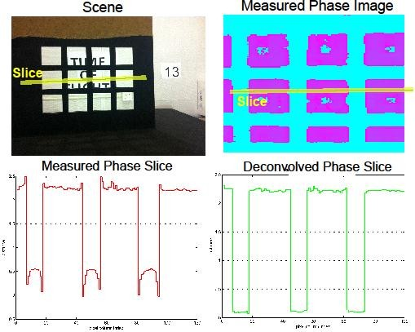
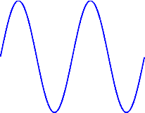
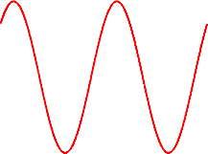
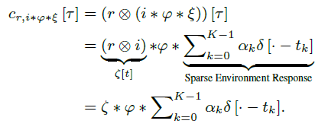

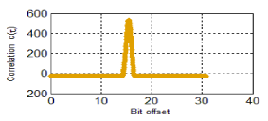

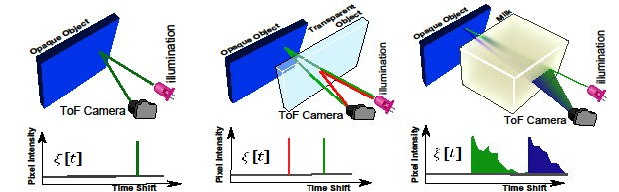



MIT Media Lab | Camera Culture | University of Waikato
Coded Time of Flight Cameras: Sparse Deconvolution to Resolve Multipath Interference
Achuta Kadambi, Refael Whyte, Ayush Bhandari, Lee Streeter, Christopher Barsi, Adrian Dorrington, Ramesh Raskar in ACM Transactions on Graphics 2013 (SIGGRAPH Asia)
http://cameraculture.info
How can we create new time of flight cameras that can range translucent objects, look through diffusers, resolve multipath artifacts, and create time profile movies?
Conventional Time of Flight Cameras
Time of Flight Cameras (ToF) utilize the Amplitude Modulated Continuous Wave (AMCW) principle to obtain fast, real-time range maps of a scene. These types of cameras are increasingly popular – the new Kinect 2 is a ToF camera – and application areas include gesture recognition, robotic navigation, etc.
Hardware Prototype. An FPGA is used for readout and controlling the modulation frequency. The FPGA is interfaced with a PMD sensor which allows for external control of the modulation signal. Finally, laser diode illumination is synced to the illumination control signal from the FPGA.
Application 1:
Light Sweep Imaging
Application 2:
Looking Through Diffuser
Comparing Different Codes
A time of flight camera sends an optical code and measures the shift in the code by sampling the cross- correlation function.
Conventional ToF Cameras use Square or Sinusoidal Codes.
Forward Model: Convolution with the Environment
The cross-correlation function is convolved with the environment response (here, noted as a delta
Here light is visualized sweeping across a checkered wall at labelled time slots. Colors represent different time slots. Since we know the size of the checkers, we can estimate time resolution.
(left): The Measured Amplitude Image. (right): The Component Amplitude
function).
Application 3:
Ranging of Translucent Objects
Application 4:
Correcting Multi-Path Artifacts
A conventional time of flight camera measures incorrect phase depths of a scene with edges (red). Our correction is able to obtain the correct depths (green).
We compare different codes. The codes sent to the FPGA are in the blue column. Good codes for deconvolution have a broadband spectrum (green). The autocorrelation of the blue codes is in red. Finally, the measured autocorrelation function (gold) is the low pass version of the red curves. The low pass operator represents the smoothing of the correlation waveform due to the rise/fall time of the electronics.
For a simple object, such as a wall, the environment response can be modelled as a single dirac.
y
A wall further away would have a shifted dirac.
y
The code we use is the m-sequence, which has strong autocorrelation properties. The code that conventional cameras use is the square code, which approximates a sinusoid when smoothed.
Forward Model: Convolution with Multi-Path Environment
Consider a scene with mixed pixels, e.g., a translucent sheet in front of a wall.
(left) range map taken by a conventional time of flight camera. (middle) We can “refocus” on the foreground depth, or (right) the background depth.
Multi-Path scenarios occur at any edge.
Comparing Different Sparse Programs
In equation form, we express the resulting convolution:
For this system, true sparsity is defined as:
The resulting environment response is no longer 1-sparse. In this figure it is modelled as 2-sparse.
y
y
To solve this problem we consider greedy approaches, such as Orthogonal Matching Pursuit (OMP). We make two modifications to the classic OMP that are tailored for our problem:
When convolved with a sinusoid (top row), the resulting measurement, y, is another sinusoid, which results in a unicity problem.
Perhaps the solution lies in creating a custom correlation function (bottom row).
y
Modification 1: Nonnegativity.
Consider only positive projections when searching for the next atom.
When updating the residual, use a solver to impose positivity on the coefficients (we use CVX).
We compare different programs for deconvolving the measurement (upper-left) into the constituent diracs. A naïve pseudo-inverse results in a poor solution. Tikhonov regularization is better, but lacks the sparsity in the original signal. The LASSO problem is decent, but has many spurious entries. Finally, the modified orthogonal matching pursuit approach provides a faithful reconstruction (bottom-right).
We can express this in a Linear Algebra Framework:
Environment Profiles are often sparse. At left is a one-sparse environment function, at middle is the environment response resulting from a transparency.
Modification 2: Proximity Constraints.
Related Work:
Velten, Andreas, et al. "Femto-photography: Capturing and visualizing the propagation of light." ACM Trans. Graph 32 (2013).
Heide, Felix, et al. "Low-budget Transient Imaging using Photonic Mixer Devices." Technical Paper to appear at SIGGRAPH 2013 (2013).
Raskar, Ramesh, Amit Agrawal, and Jack Tumblin. "Coded exposure photography: motion deblurring using fluttered shutter." ACM Transactions on Graphics (TOG). Vol. 25. No. 3. ACM, 2006.
At right is a non-sparse environment profile. To recover these, a Tikhonov Deconvolution is used .
Because we have expressed this as a linear inverse problem, we have access to techniques to solve sparse linear inverse problems.

