Slide 1
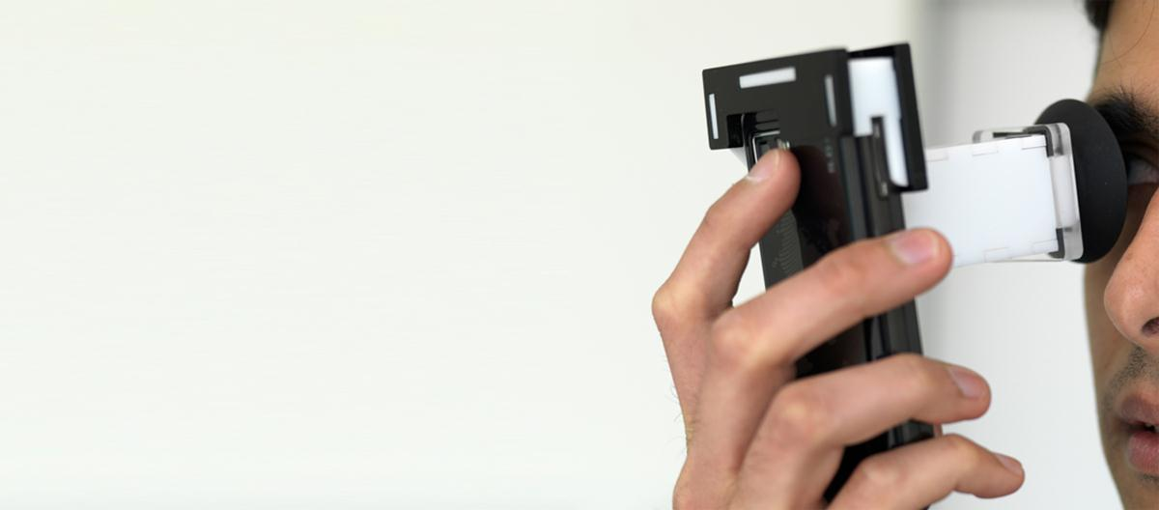
Democratizing Health Diagnostics
Ramesh Raskar
Associate Professor
MIT Media Lab
http://raskar.info
raskar@media.mit.edu

Slide 2
Medical Diagnostic Devices
Notes:
Hello and Namaste
How many of you own a high end diagnostic instrument
That is not surprising ..

Slide 3
Slit Lamp for Cataracts
Notes:
Bulky, expensive , trained professionals
Here is a cataract exam with a slit lamp .. A device that hasn’t really changed for decades

Slide 4
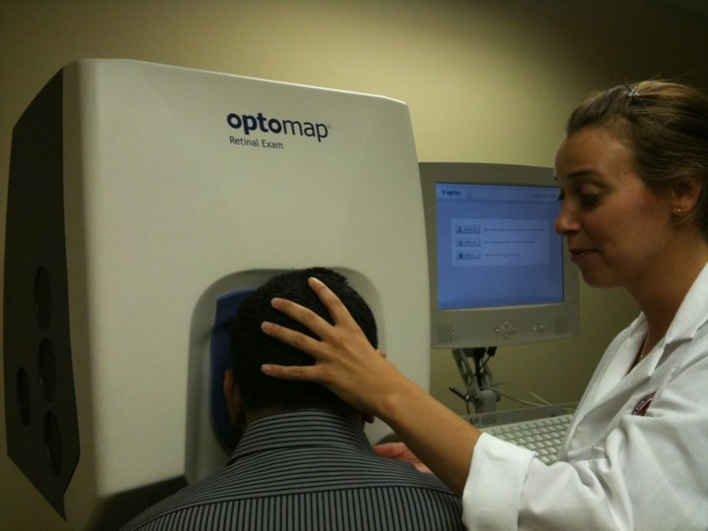
Retinal Scan
Slit Lamp Exam
Retinal Scan
Notes:
And here getting a retinal scan .. But checkout the user interface .. It is a quarter million dollar device but the nurse has to shove my head into the eyepiece

Slide 5
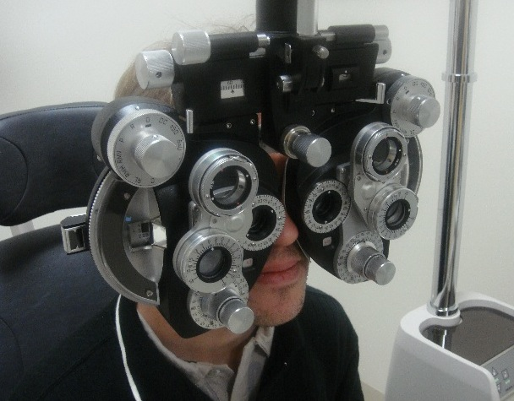
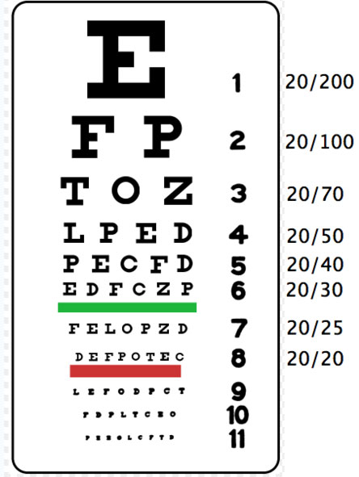
Reading Charts
Phoropter
Notes:
And here to get eyeglasses, I am lost in a phoropter.
This diagnostics while a fine solution in developed countries is not going to scale in developing countries lack of diagnostics .. Millions worldwide are suffering from conditions that have proven treatments
Reading charts appear to be an easy solution, this method has too many problems. Sharpness of legible text is very subjective. The brightness of the chart has to be very carefully chosen otherwise the pupil size will change, increasing depth of field, and allowing user to recognize even lower rows.
The trial lenses + the lens frame the doctor will use also cost over $150
% Reading chart tests involve using a frame or a phoropter. The doctor will swing a sequence of lenses in front of your eye and ask for which lens allows you to see the lower rows on the reading chart.

Slide 6
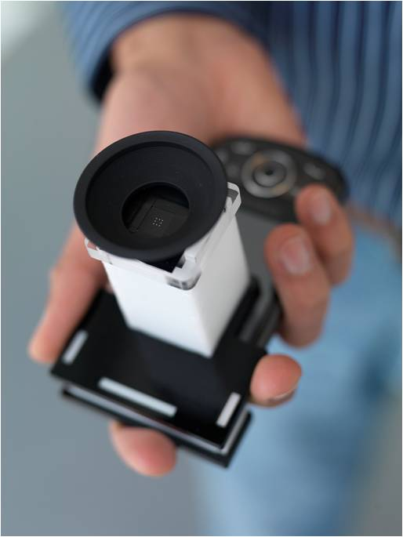
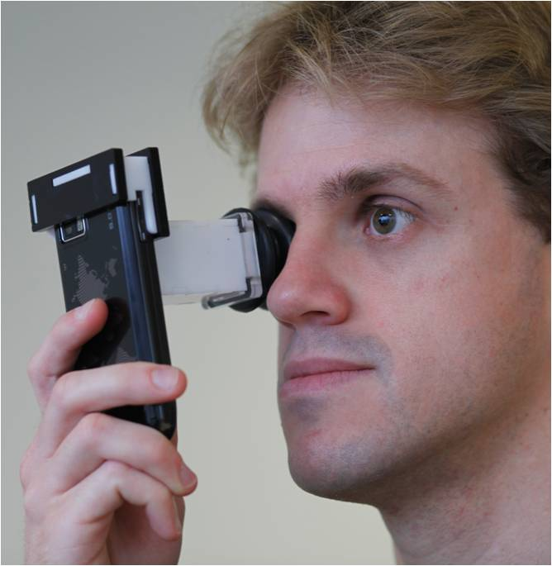
NETRA Near Eye Tool for Refractive Assessment
Vitor Pamplona, Ankit Mohan, Manuel Oliveira, Ramesh Raskar SIGGRAPH 2010
Notes:
Imagine
We call our tool NETRA: a one dollar clip on eye piece that goes on top a cellphone
near eye tool for refractive assessment
such as nearsightedness/far/astigmatism

Slide 7
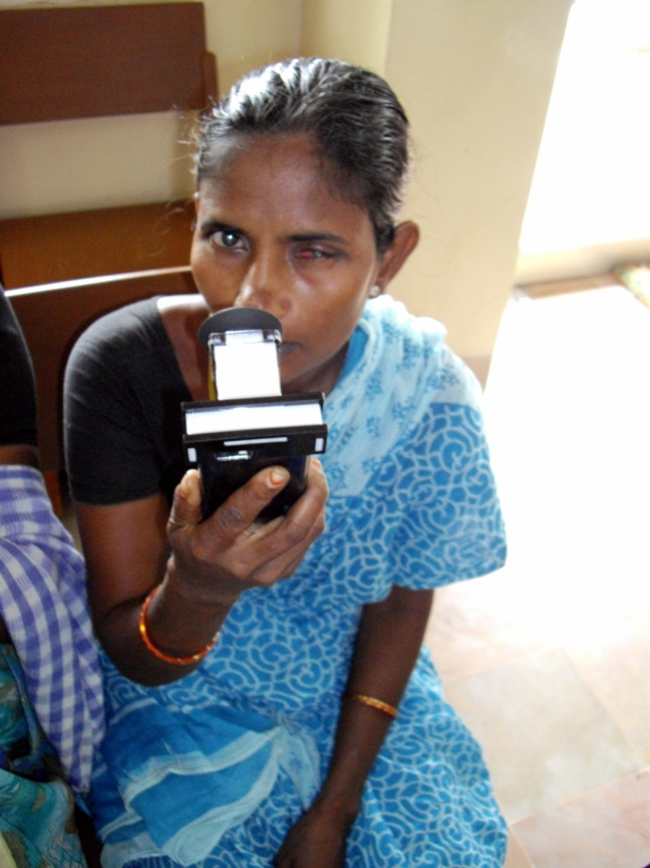
0.6B without glasses
2B
refractive errors
4.5B
cell phones
7 Billion
people
NETRA at LVP Eye Institute
Notes:
2 billion people have refractive errors
And half a billion mostly in developing countries worldwide have uncorrected vision that affects their daily livelihood.
Country like India only 10K optometrists for 1B people, and many smaller countries no optometrists at all
Blurry vision leads to illiteracy, unemployement and poverty
More phones that toothbrushes and people who make less than a dollar
They don’t have access to an optometrist or it simply too expensive.
While making and distributing of lenses has become quite easy now, surprisingly there is still no easy solution for measuring eyesight.
Can we use a fraction of the 4.5B cellphone displays to address this problem?

Slide 8
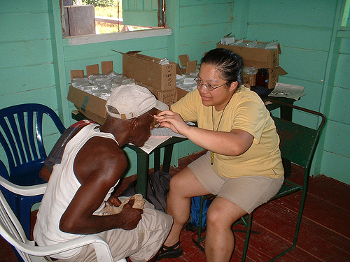
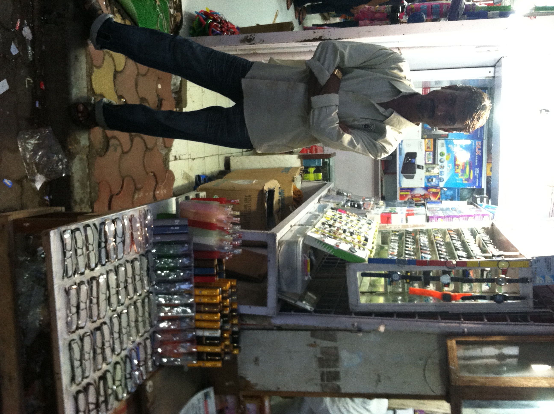
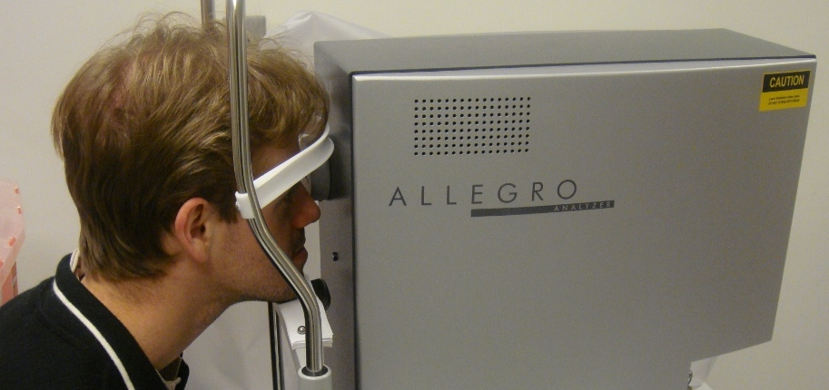
Diagnostics
Dispensing Glasses
Bulky Equipment , Trained Professionals
Increasingly cheap and easy
Notes:
There are two pieces to the puzzle of providing eyeglasses
Diagnostics and dispensing. Over time, the cost of providing eyeglasses has come down dramatically and this shop here in Mumbai can sell distant vision glasses for under $3 and still make profits. But there is still no easy solution for diagnosis ..
Country like India only 10K optometrists for 1B people, and many smaller countries no optometrists at all
While making and distributing of lenses has become quite easy now, surprisingly there is still no easy solution for measuring eyesight.
Can we use a fraction of the 4.5B cellphone displays to address this problem?

Slide 9
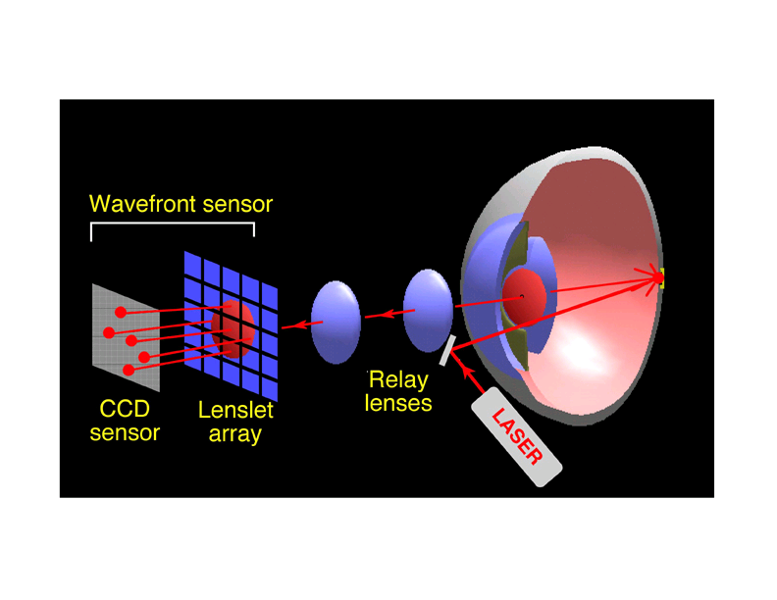
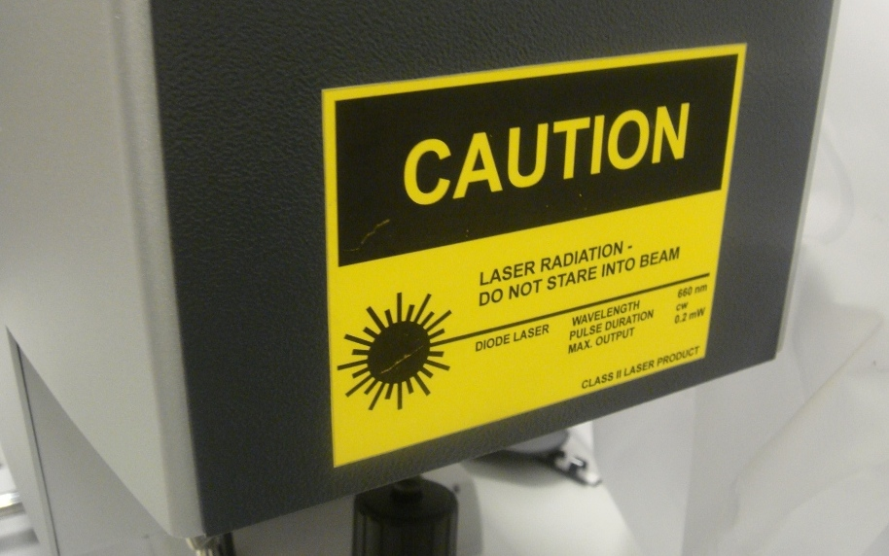
Shack-Hartmann WS
Refraction Map using Wavefront Sensor
Wavefront aberrometer
Notes:
The most accurate method is based on a so called SH WS that you would use to get a refraction map before a Lasik surgery. I love this kind of stuff.
My group at MIT Media Lab invents crazy cameras and displays: a camera that can look around corners beyond the line of sight that costs a million dollars, a portable CAT scan machine, glasses free 3D displays ..
But every once a while I like to boil down all the mathematics, optics and theory into something really modest that costs just a dollar
Netra is actually exactly opposite of this complicated laser based sensor
============
It involves shining a laser at the back of the retina and observing the wavefront using a sophisticated sensor.
We ask user to generate a spot diagram. But navigating in a high dimensional space is
challenging so we come up with a strikingly simple approach to let the user interactively create the spot
diagram.
We are first to make connection between Shack Hartmann and Lightfields (and it goes well with recent
work in computational photography about ALF and Zhang/Levoy). Connection to Adaptive optics/
Astronomy.
The way that this device works is that, it shines a lasers in the eye, the laser is reflected in the retina and comes out of the eye being distorted by the cornea. These light rays reaches an array of lenses that focus them to dots in a sensor. The device measures how much this dots deviate from the ideal case. Since it uses lasers, the device is expensive and requires trained professionals

Slide 10
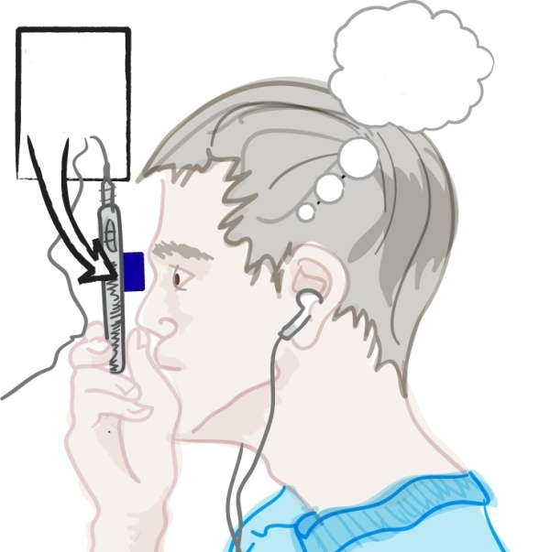
NETRA = Inverse of Shack-Hartmann wavefront sensor
User interactively creates the Spot Diagram
Spot Diagram on LCD
CellPhone LCD
2. Displace spots till single dot perceived
1. Displace 25 spots with smart UI
EyePiece
Notes:
We ask the user to manipulate patterns on the LCD screen so that the user perceives only a single dot at the end.
The number of clicks it takes to align in each directions gives us your complete spherical and cylindrical parameters
==============
Netra is based on a light wavefront sensor but acting in reverse.
A traditional wavefront sensor, called Shack Hartmann sensor involves shining lasers into the eye and using a high quality detector to record reflected light.
Netra is basically the inverse of such wavefront sensor. We ask the user to manipulate patterns on the LCD screen so that the user perceives only a single dot at the end.
For eye with distortion, the user will interactively displace the 25 points so that he will see a single spot. Of course changing 25 spot locations is cumbersome, but we realize that there are only 3 parameters for eye-prescription and we help the user navigate thru this space efficiently.
But if you think about these theory, you will realize that we have the dual of the shack-hartmann. First we though out the laser.

Slide 11
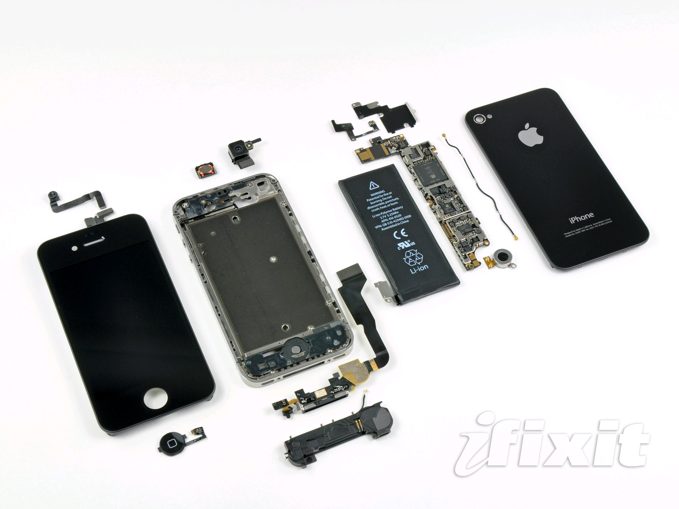
300+ DPI LCDs
Notes:
This is mobile phones today but was not possible even 3 years ago
The reason is phone makers are rapidly increasing the resolution of the screens
Why because we all want to watch out favorite episodes in HD
The pixel pitch is now down to about 25 micrometers, half the width of a human hair
At that resolution we can cleverly exploit the phone as a scientific instrument
So pl go and watch more HD content and play HD games and help build the next mobile diagnostic device

Slide 12
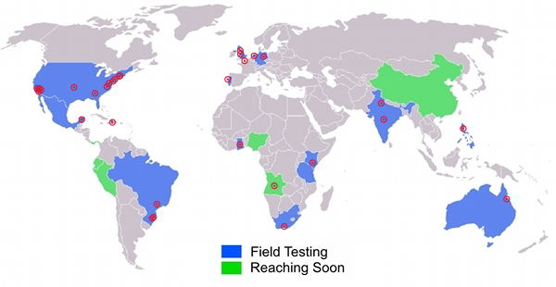
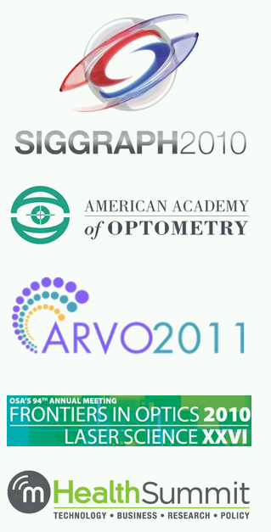
NETRA Worldwide
Notes:
Thanks to the portable, no mechanically moving parts, and low cost, we have received a tremendous response in a very short time. Netra is working with NGOs in more than a dozen countries, collaborating with eyeclinics, research centers and glasses-makers. Plus multiple IRB approved trials.
And as a professor what delights me is that my students are writing a
series of prestigious academic papers in the geekiest of journals

Slide 13
Kenya
Thermometer for Eye
Notes:
Blurry vision is not life threatening but often gets overlooked
We can give children a shot at decent education with early diagnostics
In that sense, Netra is a thermometer for the eye, and one can check regularly as the child is growing up
Video game

Slide 14
India
Notes:
Vision is important for day labor for his employment

Slide 15
Brazil
Notes:
And sometimes its just that important to be able to watch Ronaldinho kick that soccer goal

Slide 16
Notes:
So what .. This came to a blank
Glasses may be cheap but how do we get them to people?

Slide 17
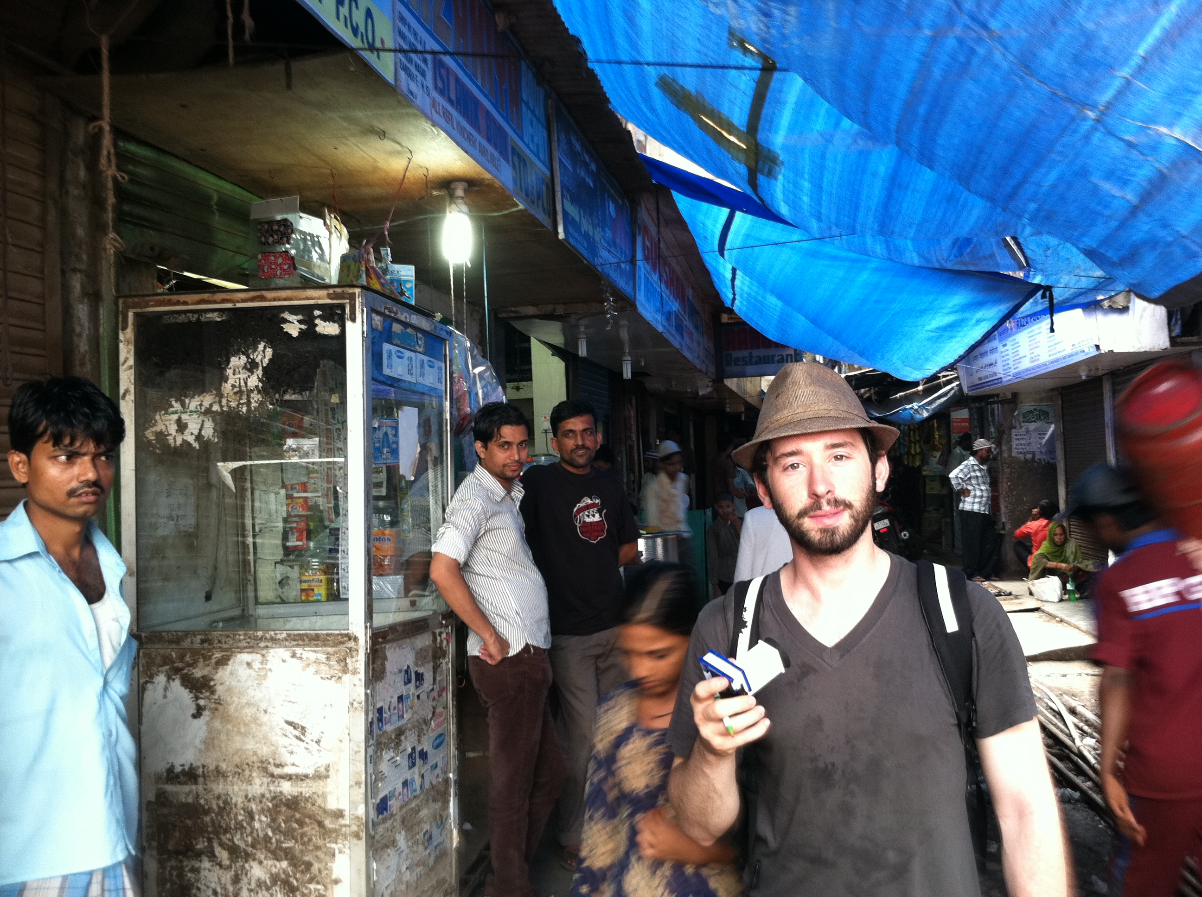
Field Study Worldwide
Notes:
So we spent the summer criss-crossing the globe. My colleague David spent a month in several cities in India studying the field and understanding the pipeline
I spent 1 month in India looking into the needs and opportunities for EyeNetra.

Slide 18
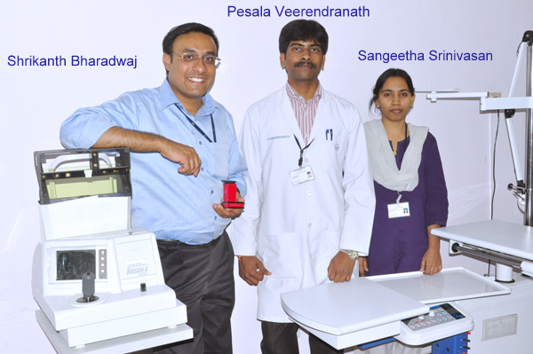
Notes:
Working with reputed eye-care organizations

Slide 19
Notes:
Optical stores

Slide 20
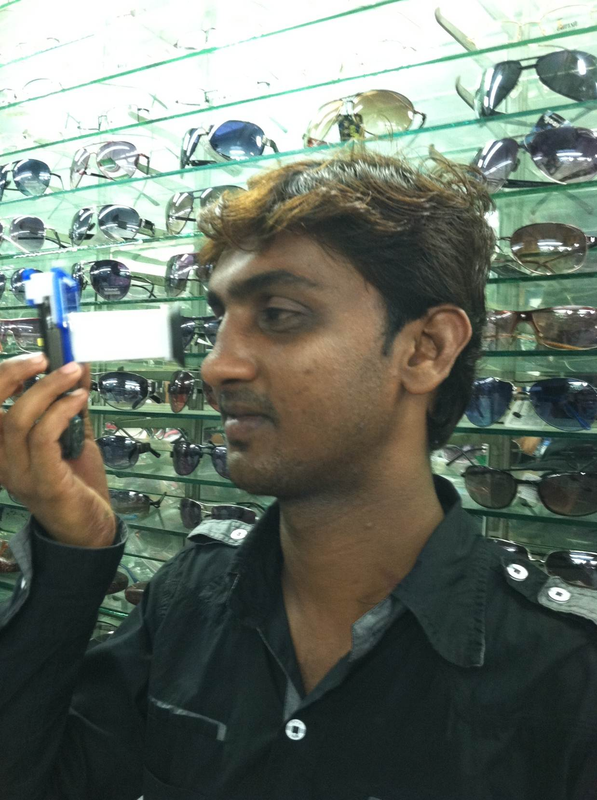
Notes:
Integrating optics, computer graphics and interactive techniques can address this worldwide problem.
So, because NETRA and CATRA are portable, low-cost, and easy to build and use, we created an initiative called EyeNETRA.com to spread these hardware apps.
We aim to increase the accessibility for eye care in remote parts of the world.
These hardware apps will empower millions of people through patient centric ecosystems that start with diagnosis and awareness.

Slide 21
Notes:
The distant vision glasses in fact are sold for $3 and yet everyone makes profit.

Slide 22
Notes:
And talked to customers
Integrating optics, computer graphics and interactive techniques can address this worldwide problem.
So, because NETRA and CATRA are portable, low-cost, and easy to build and use, we created an initiative called EyeNETRA.com to spread these hardware apps.
We aim to increase the accessibility for eye care in remote parts of the world.
These hardware apps will empower millions of people through patient centric ecosystems that start with diagnosis and awareness.

Slide 23
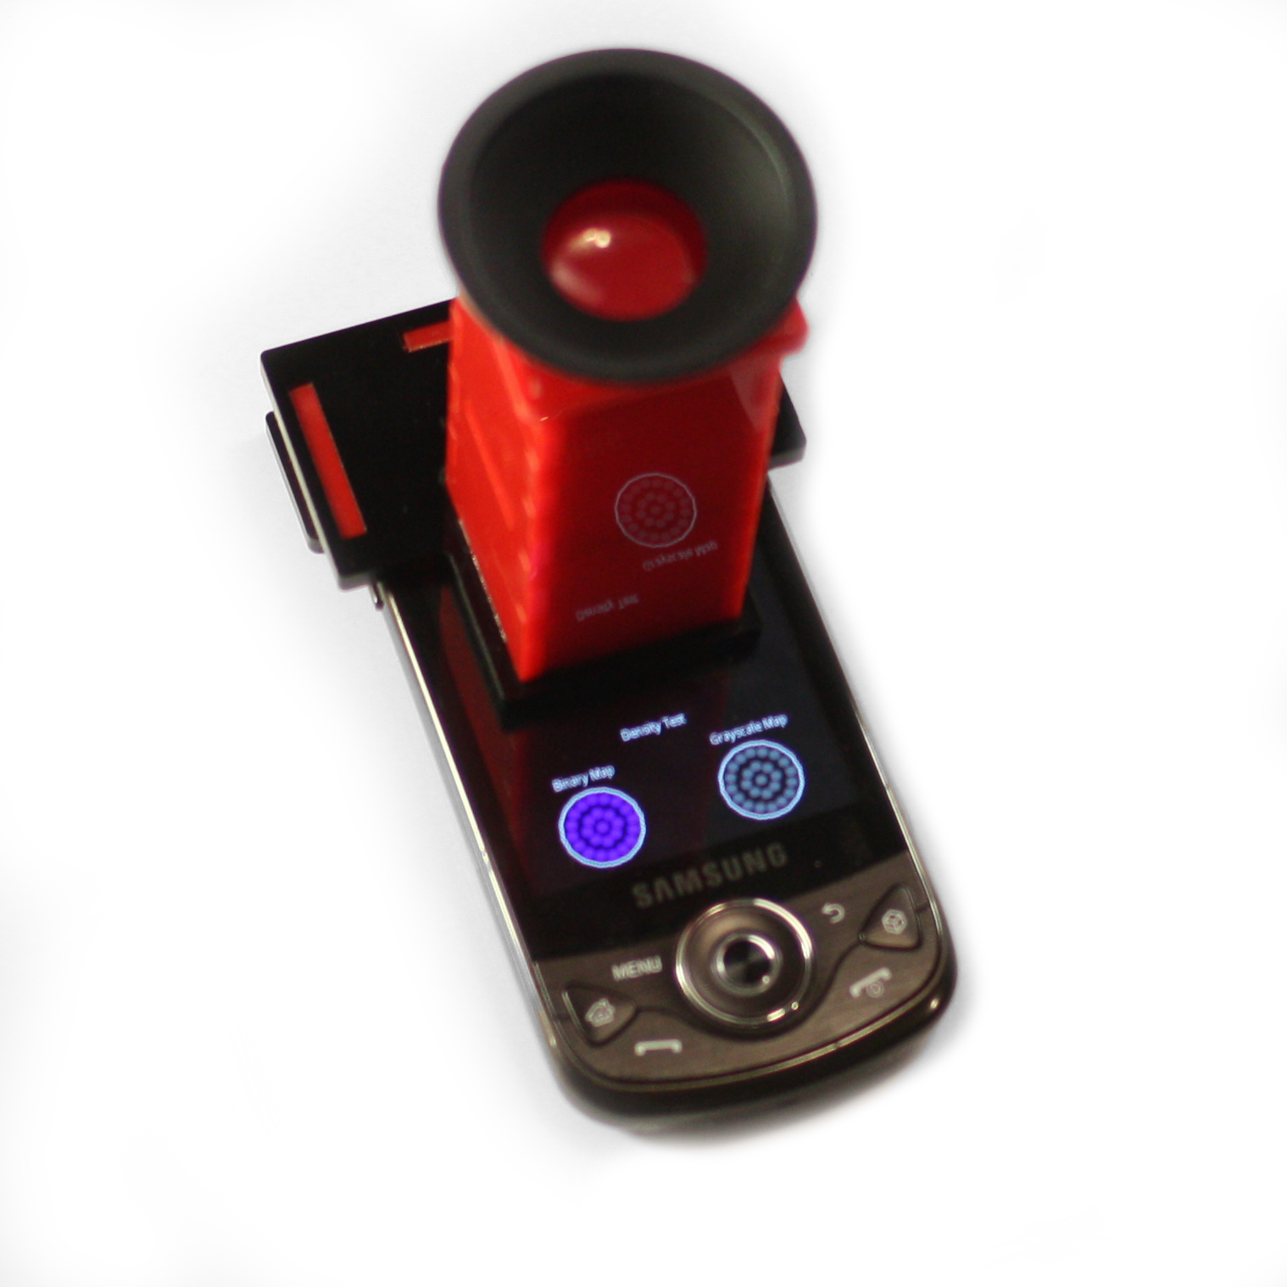
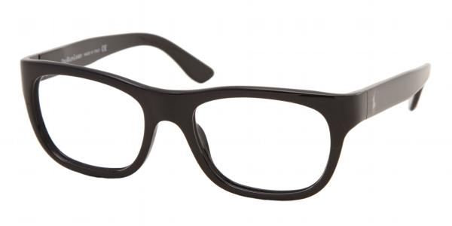
A New Ecosystem
Wireless
EHR
Eyecare
Providers
Diagnostic
Delivery
Notes:
even though our technology is radical and disruptive, we must change the system by working with current players who all can do a wonderful job in reaching the underserved for us
We reach the customer (particularly mom and pop opticals) through lens manufacturers and regional lens distributors who want to sell more lenses. We are in serious talks one of the largest lens manufacturers in the world right now.
At least 100 million reached in 3 years. (assuming year 1 is first year of production)
Our device enables a whole new ecosystem of eye care which brings care close to the patient’s home. Staring with demand generation and ending in access to care (ie eyeglass delivery) through the mobile network.

Slide 24
Notes:
So we have spun-out a venture to impact this ecosystem .. And we continue to look for additional funding and team members right here in mumbai
Integrating optics, computer graphics and interactive techniques can address this worldwide problem.
So, because NETRA and CATRA are portable, low-cost, and easy to build and use, we created an initiative called EyeNETRA.com to spread these hardware apps.
We aim to increase the accessibility for eye care in remote parts of the world.
These hardware apps will empower millions of people through patient centric ecosystems that start with diagnosis and awareness.

Slide 25
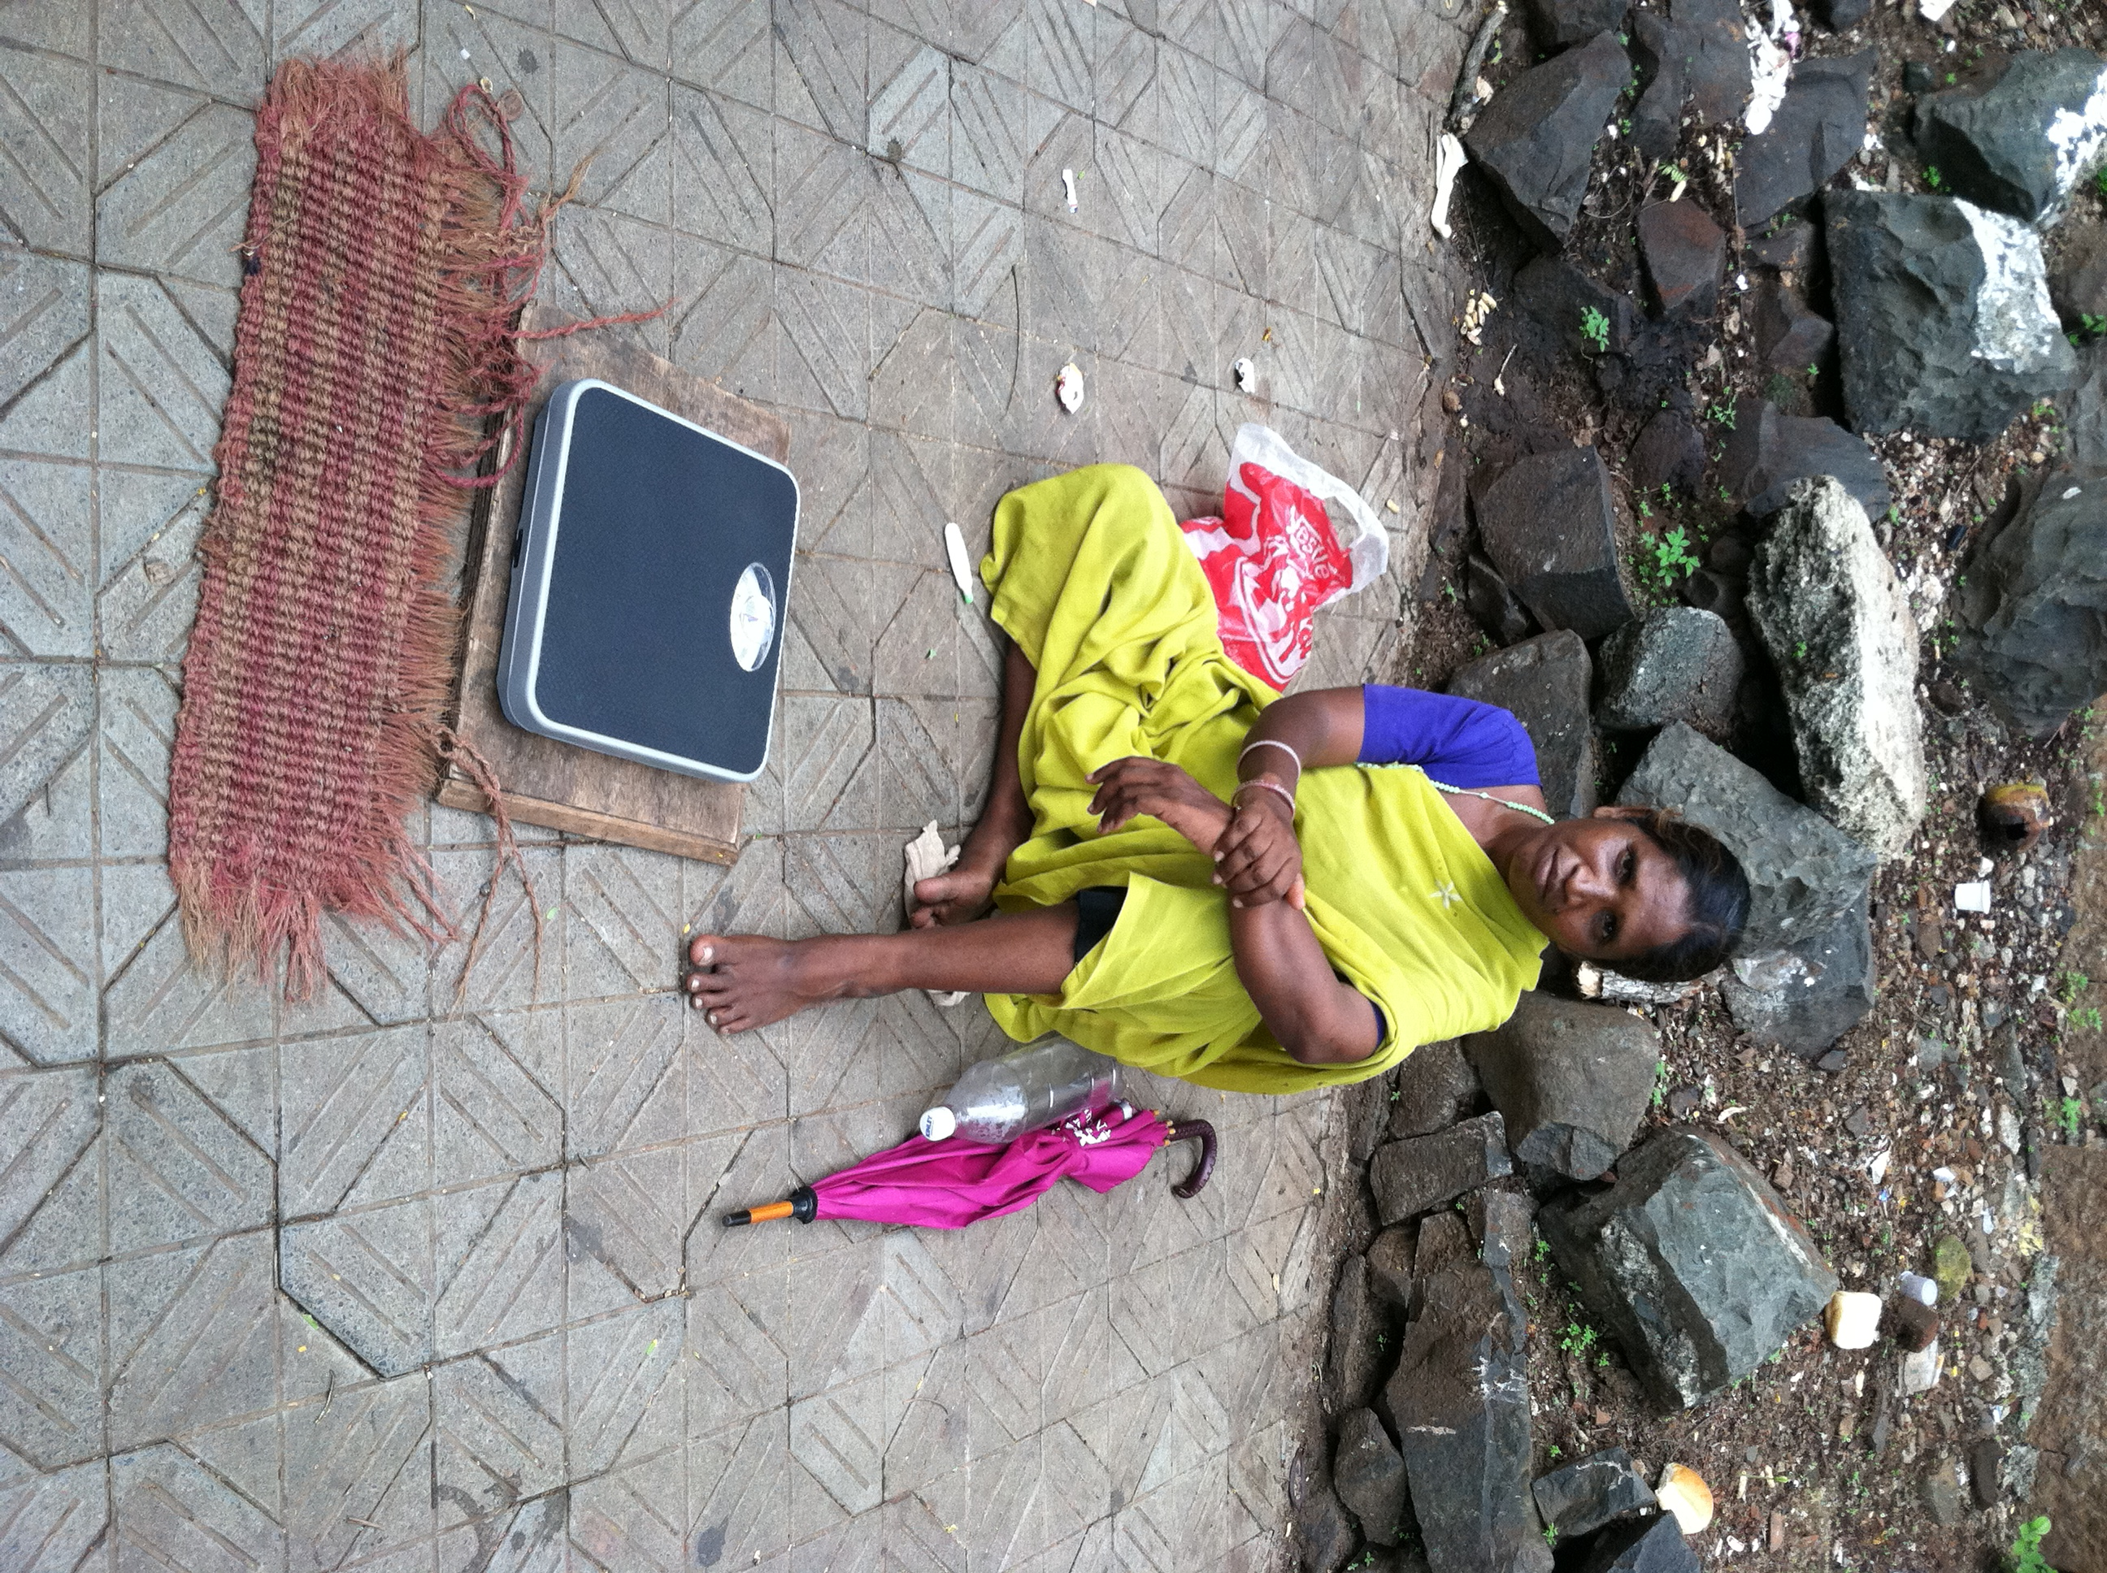
Photo of women and weighing scale
Entrepreneur
Notes:
And meeting this woman outside Hyderabad was a turning pt and made us
realize how these micro-entreprenuers will take technology to masses and scale it in unimaginable ways
if we had any doubt
Not only bring those with blurry vision into the real world
But in fact provide new jobs
New micro-entreprenuer models (like grameen phone)
These entreprenuer will technology to masses in scale and in unimaginable ways

Slide 26
Hardware App Store
Notes:
We all know about software app store, but now we are entering an era of hardware app store where a dollar or two clip on created by developers will be useful for health, productivity, entertainment and education.
Not just a communication or computer device

Slide 27
Hardware App Store
Notes:
We all know about software app store, but now we are entering an era of hardware app store where a dollar or two clip on created by developers will be useful for health, productivity, entertainment and education.
Not just a communication or computer device

Slide 28
Mobile Mates for Health
Notes:
Mobile mates: low-cost attachments that can provide diagnostics in remote parts
Much like landlines, we cannt expect the hospitals and clinics to reach the billions .. We must leapfrog ..
cheap device on a phone that allows diagnostics in remote
parts of the world, bring them to doorstep/portable
You may have seen devices attached to the phone to provide service but here the phone is just data collector and computer.
(Show example of devices where medical device is simply connected to phone)
My aim is to convert the myriod of sensors embedded in mobile phones into a scientific instrument

Slide 29
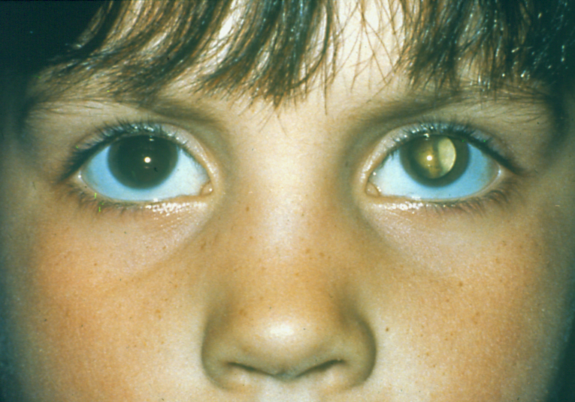
Cataract
Slit Lamp Exam
Notes:
When we talk to our NGO partners, they wanted us to solve cataract screening as that is the leading cause of preventable blindness.
But seems quite challenging to compete with a slit lamp exam.
Cataract leads to blindness and often lazy eye
Because there is no automated way to find cloudiness, doctors use subject analysis. But we think individuals are best suited.
Power for user intelligence can overcome very cumbersome and expensive devices.
But unlike other condition eye screening is quite challenging.
Modern solutions may provide students a fighting chance is a very rewarding.

Slide 30
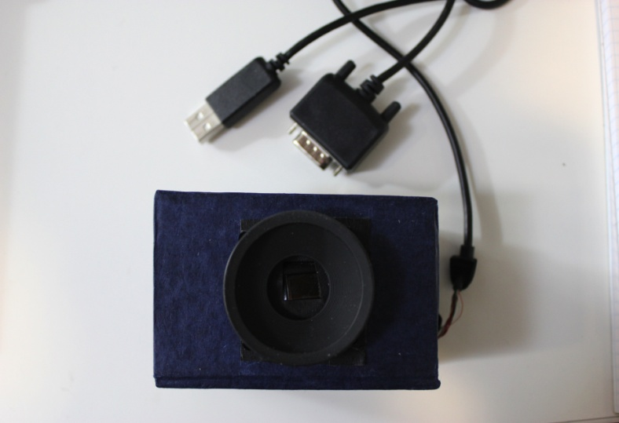
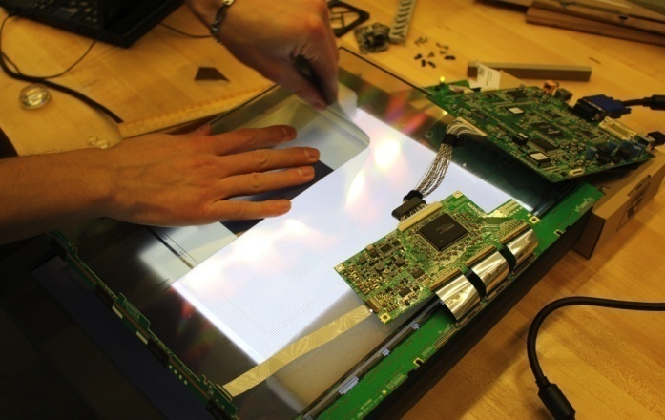
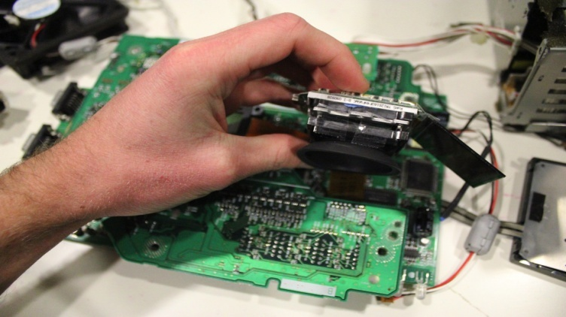
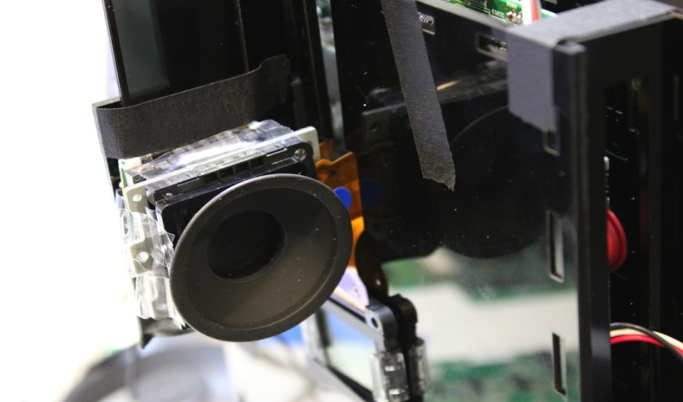
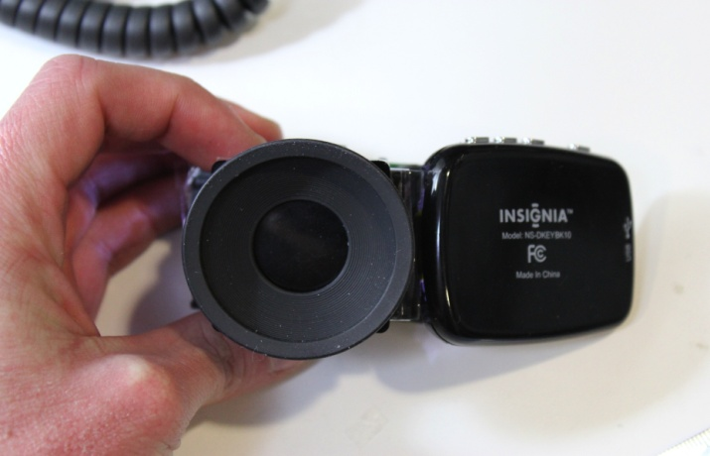
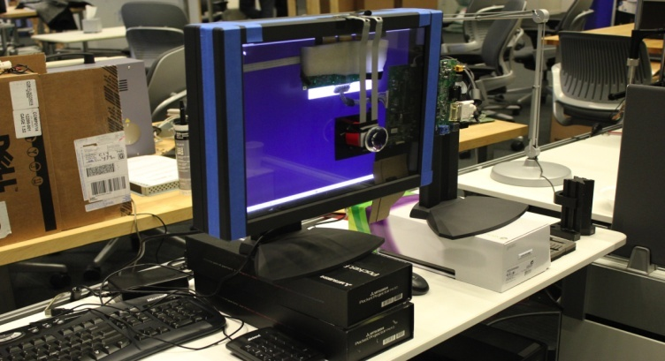
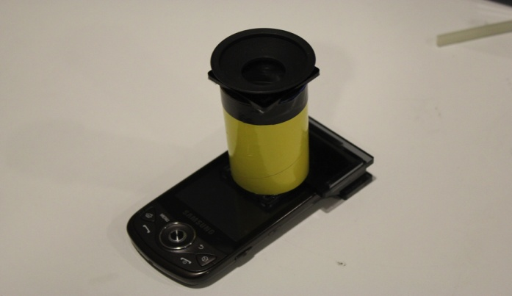
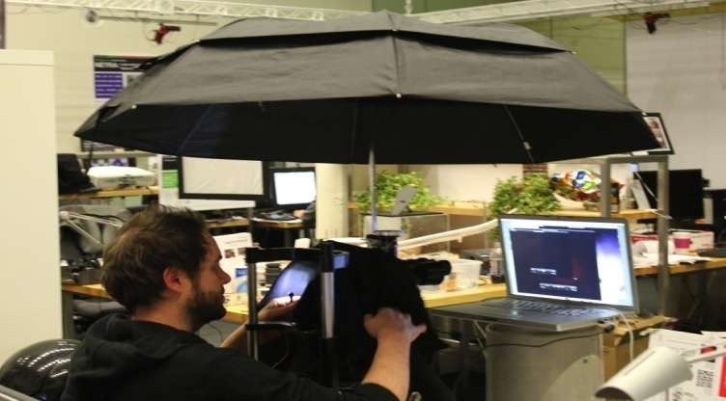
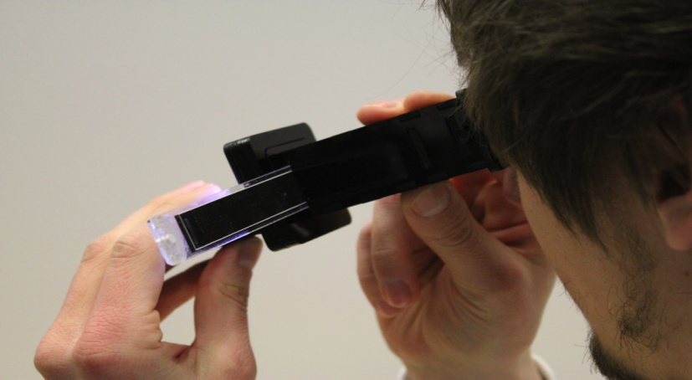
Notes:
So we went back to the lab and ripped open off the shelf components ..
Thanks Vitor.
We’ve built several prototypes…

Slide 31
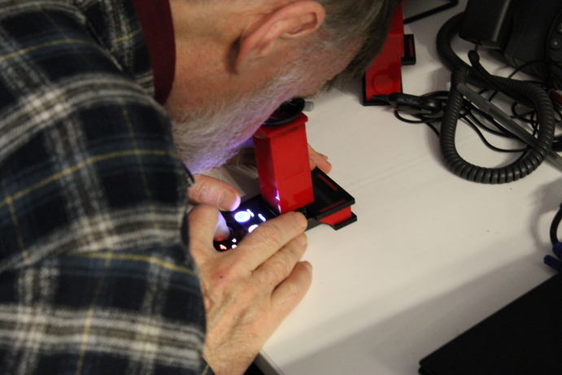
CATRA: Cataract Screening Tool
Vitor Pamplona Erick Passos Jan Zizka Manuel M. Oliveira
Everett Lawson Esteban Clua Ramesh Raskar
Notes:
Well we have another mobile mate called CATRA that looks very similar but used very different optics and algorthms
Like a radar for the eye

Slide 32
Eye is a Mirror of Health
Notes:
Why start with the eye?
Eye is a mirror of general health.
Ocular manifestation of systemic diseases such as diabetes, hypertension, infections and metabolic disorders is well known.
Is the only place in body where you cn see blood vessels non-invasively.
Like a thermometert, people are in charge of their own health although it does not give prescription

Slide 33
Mobile Mates for Health
Notes:
Refraction .. Cataract .. Mobile mates for health ..
If you get the right mobile mate for your smartphone, how many of you will have a high end medical instrument ..
Now .. That is not surprising either ..
Just think about it, over 4 billion people will soon be carrying a high end medical instrument if we can just create the right mobile mate.
Join us as designers technologists biologists social entrepreneurs .. To take affordable diagnostics everywhere with next generation of mobile mates.
Netra is the beginning.

Slide 34
Notes:
Integrating optics, computer graphics and interactive techniques can address this worldwide problem.
So, because NETRA and CATRA are portable, low-cost, and easy to build and use, we created an initiative called EyeNETRA.com to spread these hardware apps.
We aim to increase the accessibility for eye care in remote parts of the world.
These hardware apps will empower millions of people through patient centric ecosystems that start with diagnosis and awareness.

Slide 35
Notes:
Integrating optics, computer graphics and interactive techniques can address this worldwide problem.
So, because NETRA and CATRA are portable, low-cost, and easy to build and use, we created an initiative called EyeNETRA.com to spread these hardware apps.
We aim to increase the accessibility for eye care in remote parts of the world.
These hardware apps will empower millions of people through patient centric ecosystems that start with diagnosis and awareness.

Slide 36
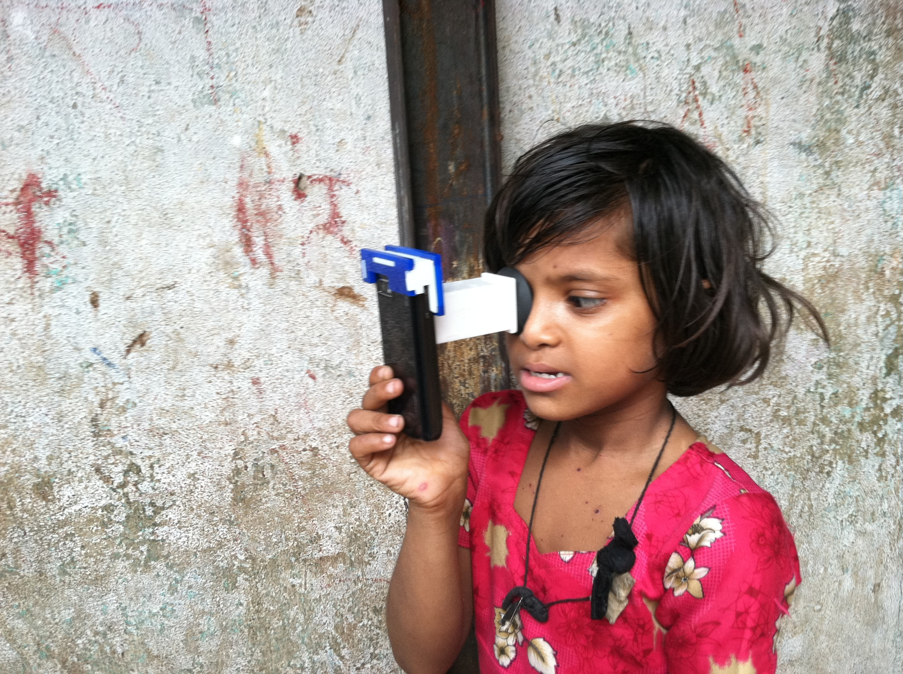
Notes:
Integrating optics, computer graphics and interactive techniques can address this worldwide problem.
So, because NETRA and CATRA are portable, low-cost, and easy to build and use, we created an initiative called EyeNETRA.com to spread these hardware apps.
We aim to increase the accessibility for eye care in remote parts of the world.
These hardware apps will empower millions of people through patient centric ecosystems that start with diagnosis and awareness.

Slide 37
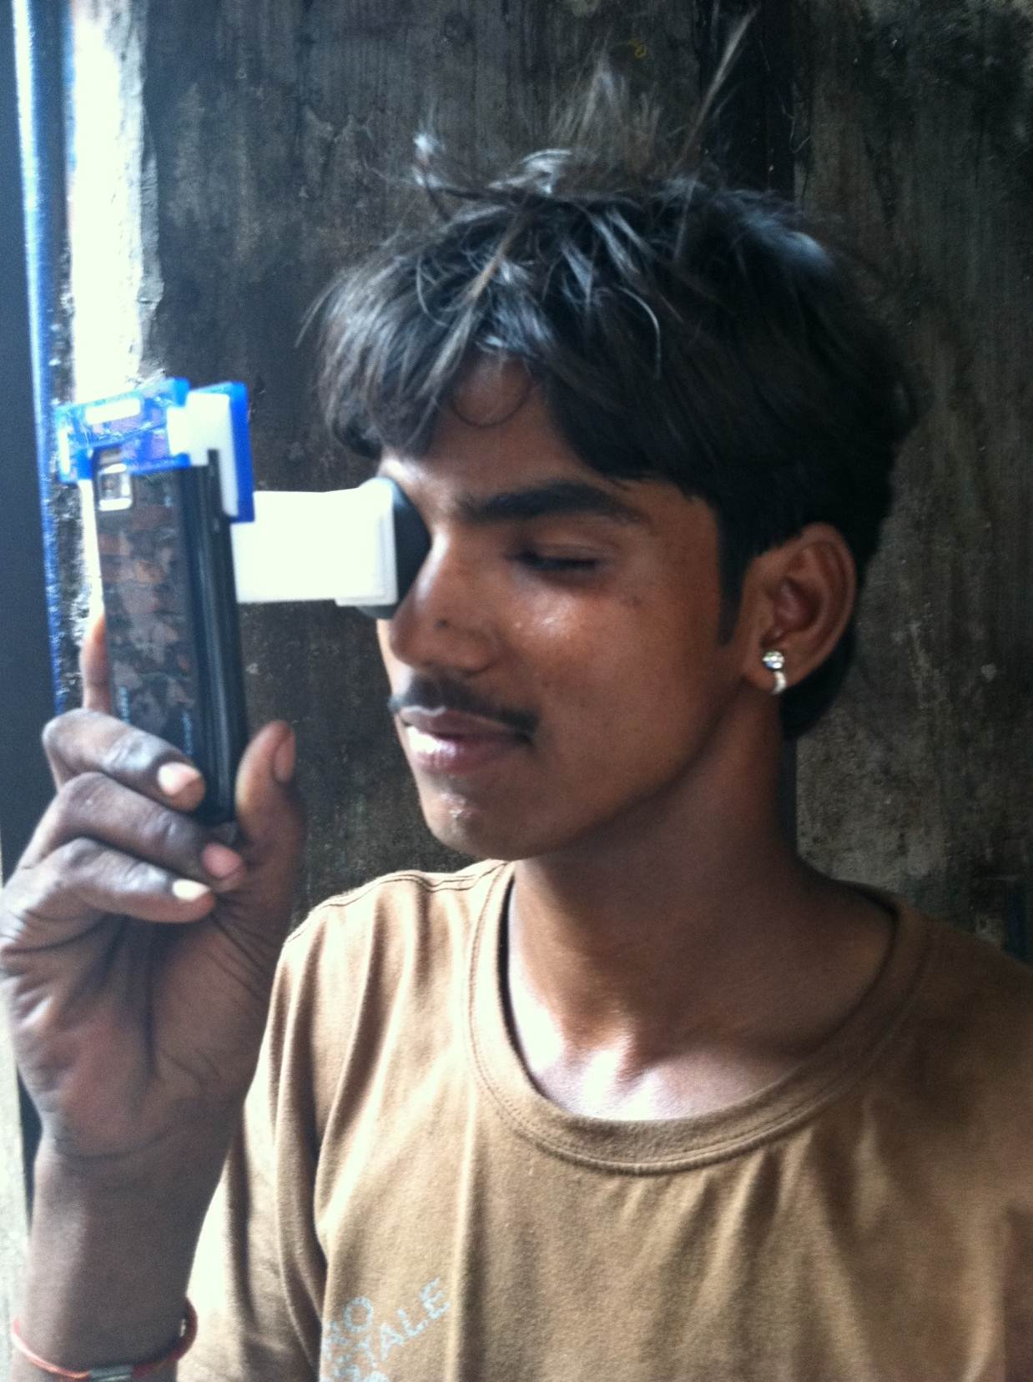
Notes:
Integrating optics, computer graphics and interactive techniques can address this worldwide problem.
So, because NETRA and CATRA are portable, low-cost, and easy to build and use, we created an initiative called EyeNETRA.com to spread these hardware apps.
We aim to increase the accessibility for eye care in remote parts of the world.
These hardware apps will empower millions of people through patient centric ecosystems that start with diagnosis and awareness.

Slide 38
Notes:
Integrating optics, computer graphics and interactive techniques can address this worldwide problem.
So, because NETRA and CATRA are portable, low-cost, and easy to build and use, we created an initiative called EyeNETRA.com to spread these hardware apps.
We aim to increase the accessibility for eye care in remote parts of the world.
These hardware apps will empower millions of people through patient centric ecosystems that start with diagnosis and awareness.

Slide 39
Notes:
Integrating optics, computer graphics and interactive techniques can address this worldwide problem.
So, because NETRA and CATRA are portable, low-cost, and easy to build and use, we created an initiative called EyeNETRA.com to spread these hardware apps.
We aim to increase the accessibility for eye care in remote parts of the world.
These hardware apps will empower millions of people through patient centric ecosystems that start with diagnosis and awareness.

Slide 40
Notes:
Integrating optics, computer graphics and interactive techniques can address this worldwide problem.
So, because NETRA and CATRA are portable, low-cost, and easy to build and use, we created an initiative called EyeNETRA.com to spread these hardware apps.
We aim to increase the accessibility for eye care in remote parts of the world.
These hardware apps will empower millions of people through patient centric ecosystems that start with diagnosis and awareness.

Slide 41
Notes:
Integrating optics, computer graphics and interactive techniques can address this worldwide problem.
So, because NETRA and CATRA are portable, low-cost, and easy to build and use, we created an initiative called EyeNETRA.com to spread these hardware apps.
We aim to increase the accessibility for eye care in remote parts of the world.
These hardware apps will empower millions of people through patient centric ecosystems that start with diagnosis and awareness.

Slide 42
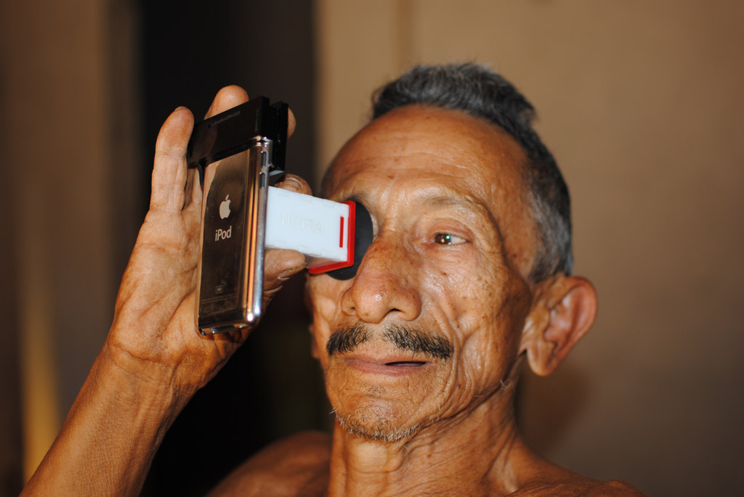
Notes:
Integrating optics, computer graphics and interactive techniques can address this worldwide problem.
So, because NETRA and CATRA are portable, low-cost, and easy to build and use, we created an initiative called EyeNETRA.com to spread these hardware apps.
We aim to increase the accessibility for eye care in remote parts of the world.
These hardware apps will empower millions of people through patient centric ecosystems that start with diagnosis and awareness.

Slide 43
Brazil

Slide 44
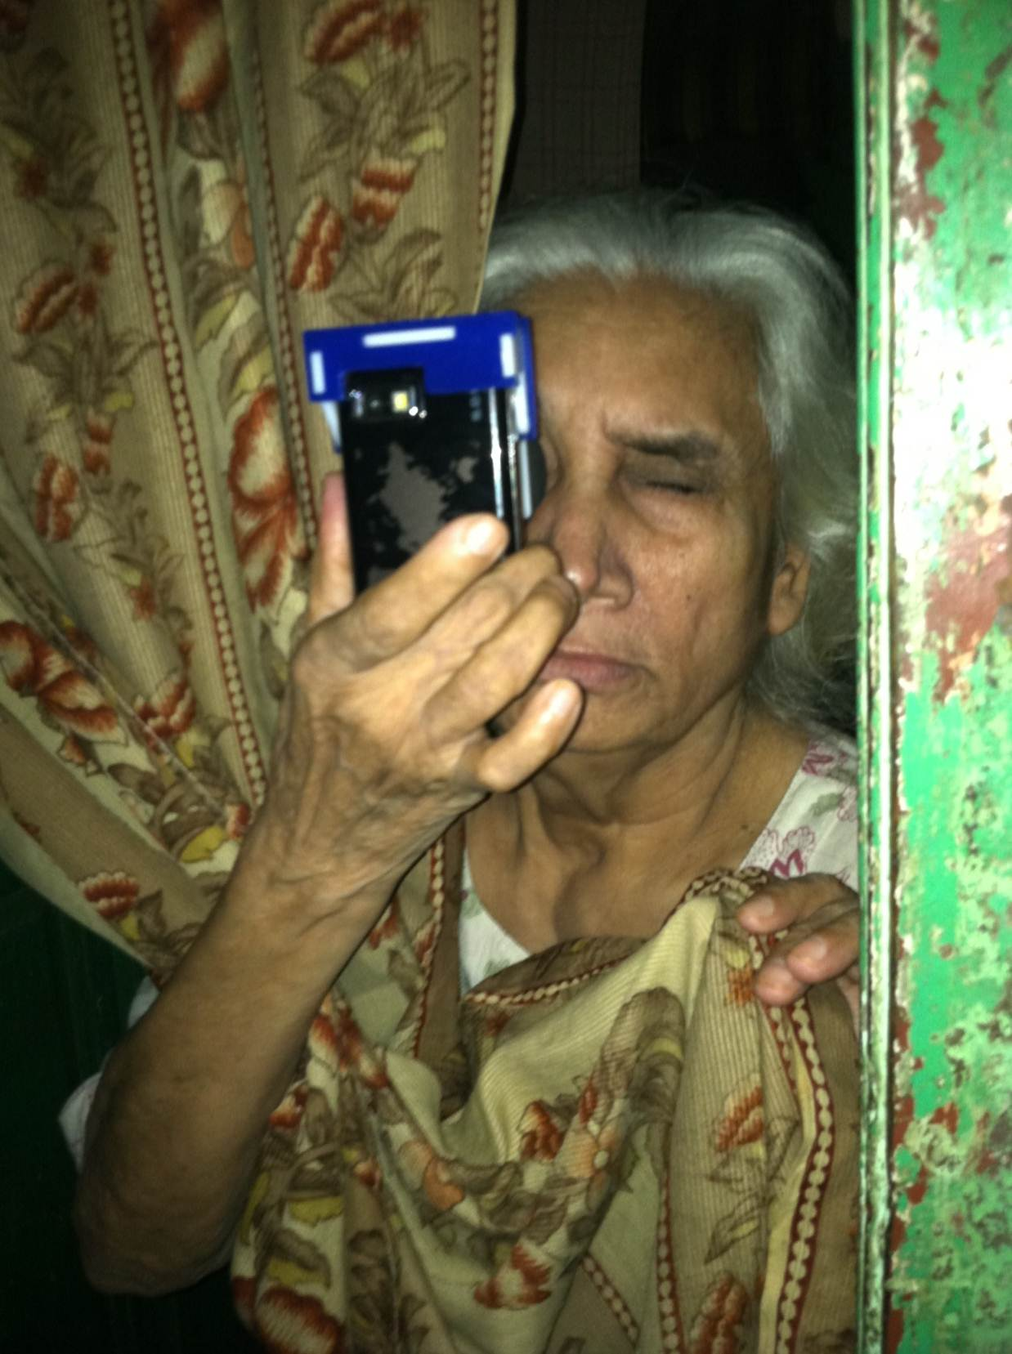
Notes:
Integrating optics, computer graphics and interactive techniques can address this worldwide problem.
So, because NETRA and CATRA are portable, low-cost, and easy to build and use, we created an initiative called EyeNETRA.com to spread these hardware apps.
We aim to increase the accessibility for eye care in remote parts of the world.
These hardware apps will empower millions of people through patient centric ecosystems that start with diagnosis and awareness.

Slide 45
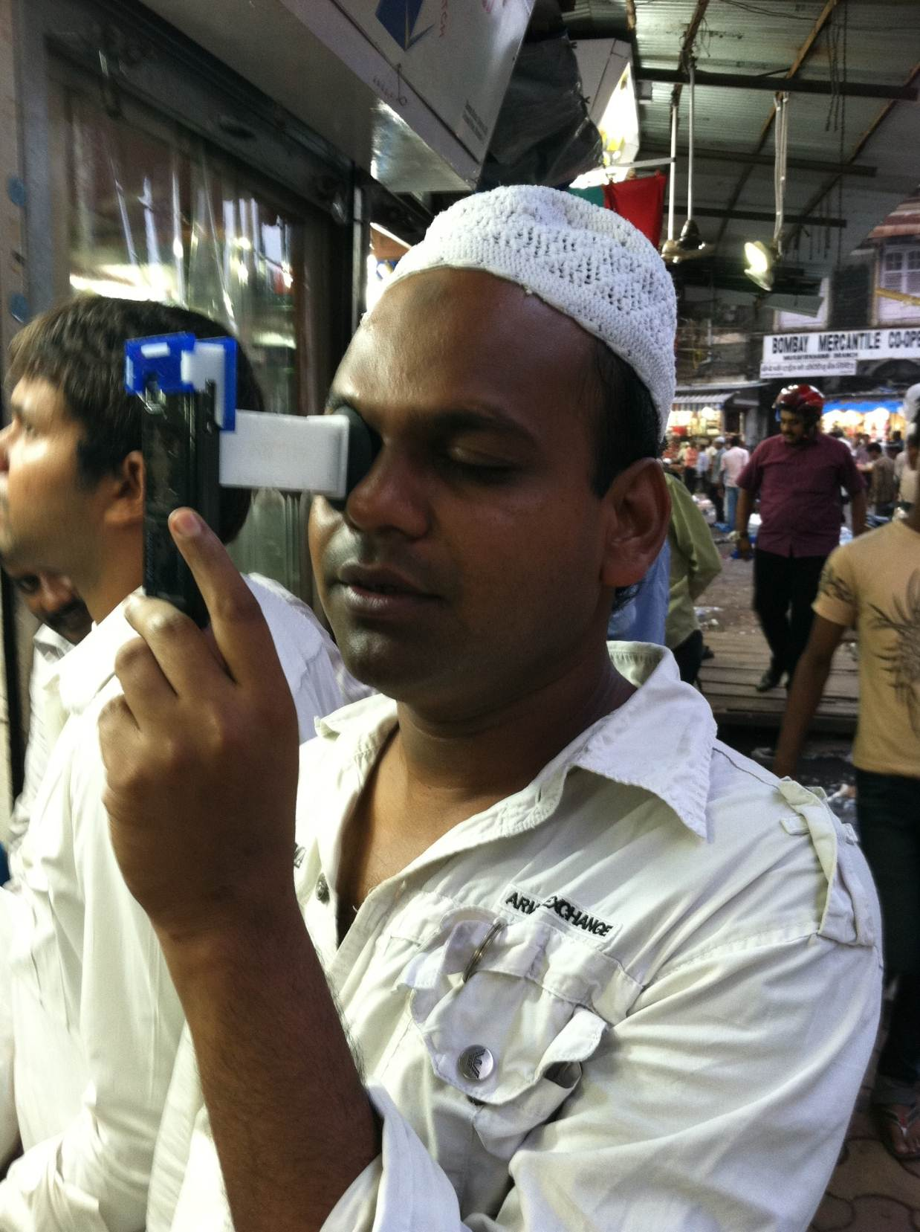
Notes:
Integrating optics, computer graphics and interactive techniques can address this worldwide problem.
So, because NETRA and CATRA are portable, low-cost, and easy to build and use, we created an initiative called EyeNETRA.com to spread these hardware apps.
We aim to increase the accessibility for eye care in remote parts of the world.
These hardware apps will empower millions of people through patient centric ecosystems that start with diagnosis and awareness.

Slide 46
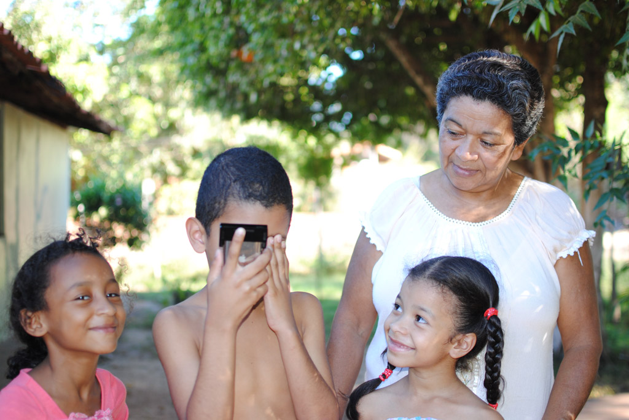
Notes:
Integrating optics, computer graphics and interactive techniques can address this worldwide problem.
So, because NETRA and CATRA are portable, low-cost, and easy to build and use, we created an initiative called EyeNETRA.com to spread these hardware apps.
We aim to increase the accessibility for eye care in remote parts of the world.
These hardware apps will empower millions of people through patient centric ecosystems that start with diagnosis and awareness.

Slide 47
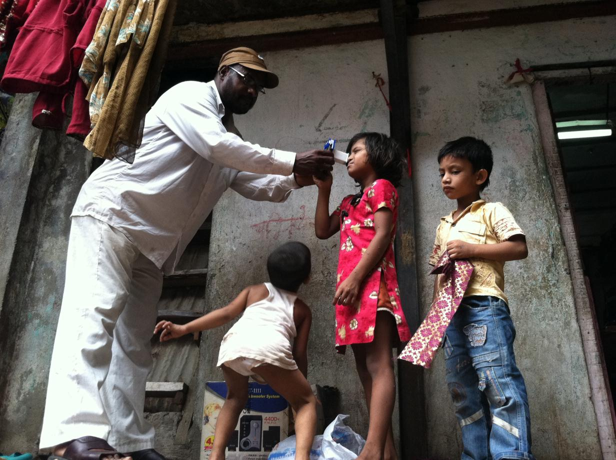
Notes:
Integrating optics, computer graphics and interactive techniques can address this worldwide problem.
So, because NETRA and CATRA are portable, low-cost, and easy to build and use, we created an initiative called EyeNETRA.com to spread these hardware apps.
We aim to increase the accessibility for eye care in remote parts of the world.
These hardware apps will empower millions of people through patient centric ecosystems that start with diagnosis and awareness.

Slide 48
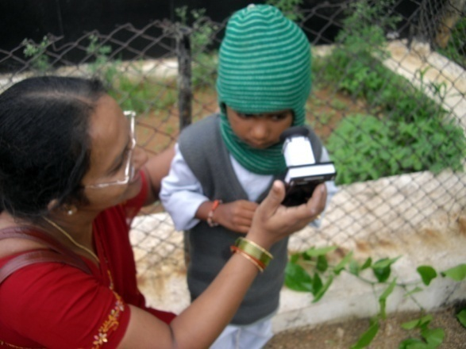

Slide 49
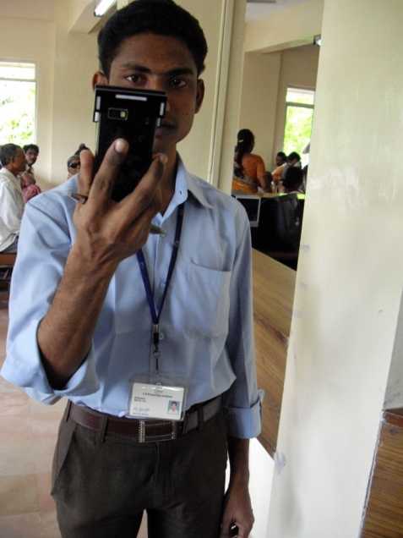

Slide 50
Notes:
Join the revolution by becoming an ambassador at eyenetra.com
Join us as designers technologists biologists social workers and entrepreneurs .. To take affordable diagnostics everywhere with next generation of mobile mates.
Netra is the beginning.
Thank you and Dhanyavad
Integrating optics, computer graphics and interactive techniques can address this worldwide problem.
So, because NETRA and CATRA are portable, low-cost, and easy to build and use, we created an initiative called EyeNETRA.com to spread these hardware apps.
We aim to increase the accessibility for eye care in remote parts of the world.
These hardware apps will empower millions of people through patient centric ecosystems that start with diagnosis and awareness.

Slide 51
Democratizing Health Diagnostics
Ramesh Raskar
Associate Professor
MIT Media Lab
http://raskar.info
raskar@mit.edu
http://eyeNETRA.com
Notes:
NETRA is a clip-on device that you attach to your cell phone. You look close, press some buttons, you hit calculate and it gives you the prescription for glasses. It’s a 2-dollar device that measures nearsightedness, farsightedness and astigmatism with the same accuracy that doctors have in their clinic.

Slide 52
END
Notes:
We all know about software app store, but now we are entering an era of hardware app store where a dollar or two clip on created by developers will be useful for health, productivity, entertainment and education.
Not just a communication or computer device

Slide 53
Notes:
I am excited about creating mobile mates for health, where the phone is not just a comm device or computer but is actually a scientific instrument.
Exploiting all the great I/O components that are being crammed into the phone.
http://www.i-micronews.com/lectureArticle.asp?id=5147

Slide 54
Experts
Devices
Patients
Patient = Underused Resource
Notes:
Bulky, expensive , trained professionals
Here is a cataract exam with a slit lamp .. A device that hasn’t really changed for decades

Slide 55
CATRA: Radar for Cloud Cover
Lens
Moving
patterns
on Screen
Pinhole
Cell Phone Display
Notes:
Catra is like a radar for your lens, scanning to find cloud cover
NETRA uses an exact inverse of this sensor. We get rid of the laser and we instead show the same spot diagram in a cellphone display. For normal eye, it will appear as a dot to the user.

Slide 57
Mobile Mates for Health
Notes:
Refraction .. Cataract .. Mobile mates for health ..
If you get the right mobile mate, how many of you will have a high end medical instrument ..
Now .. That is not surprising either ..

Slide 58
Notes:
And we can not only screen but give you a full map of the blocking and scattering in the lens, here performed by LVP in India

Slide 59
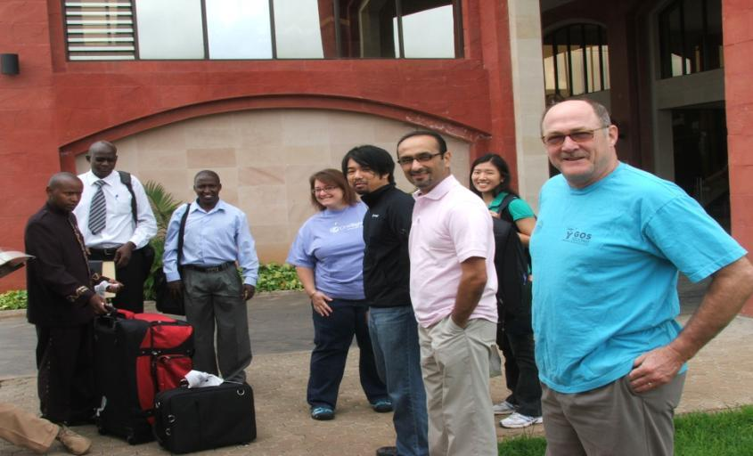
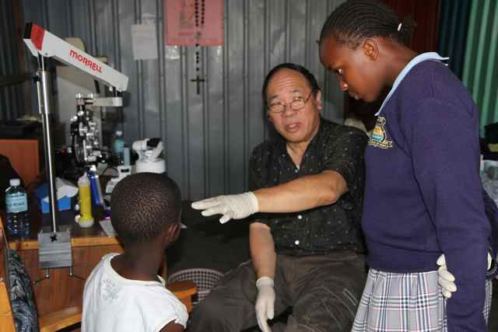
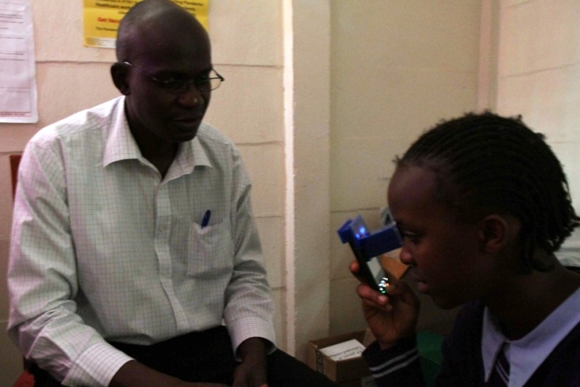
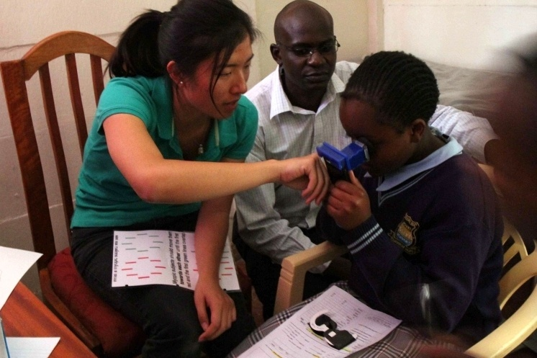
OneSight, Kenya

